Slide 1

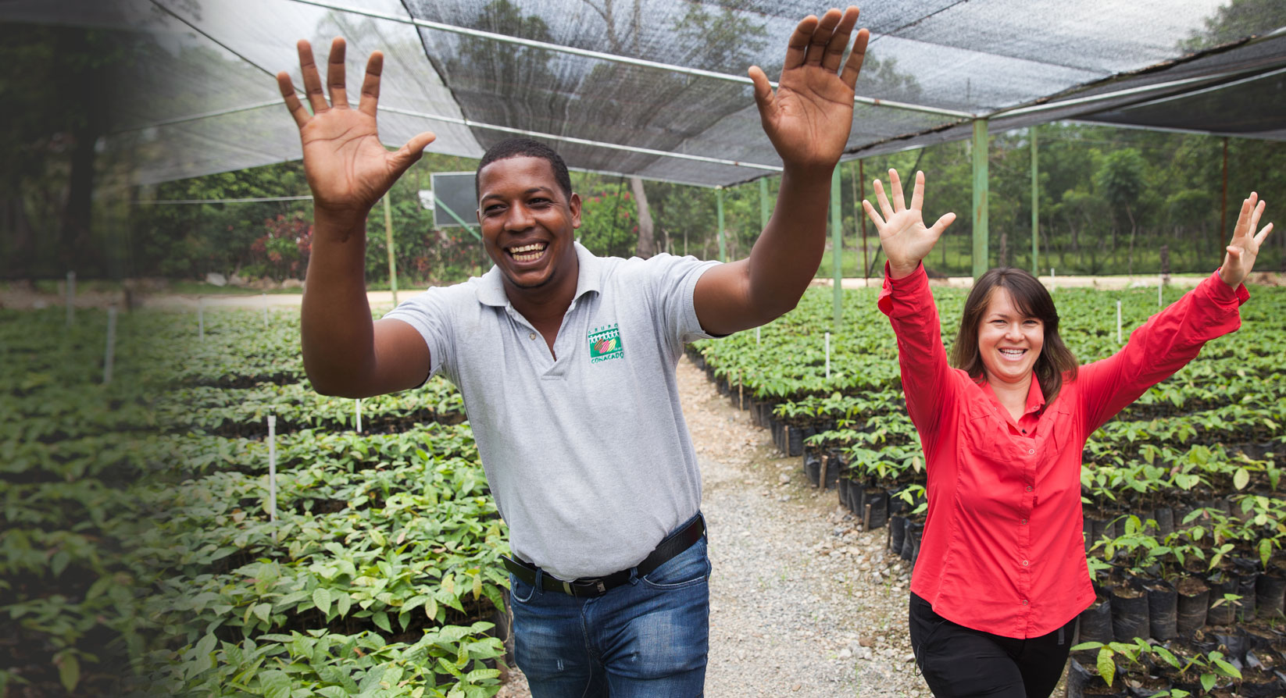

Farmers, Food, and You
Notes:
Today I’m going to share some things that matter to me and others at an organization called Equal Exchange.
I thought you might want to learn about these things, too, and even how they relate to what you will be selling in your Equal Exchange fundraiser. So, to start off…
Or, if not Fundraising:
I thought you might want to learn about these things, too, and even how they relate to your life and values. So, to start off…

Slide 2
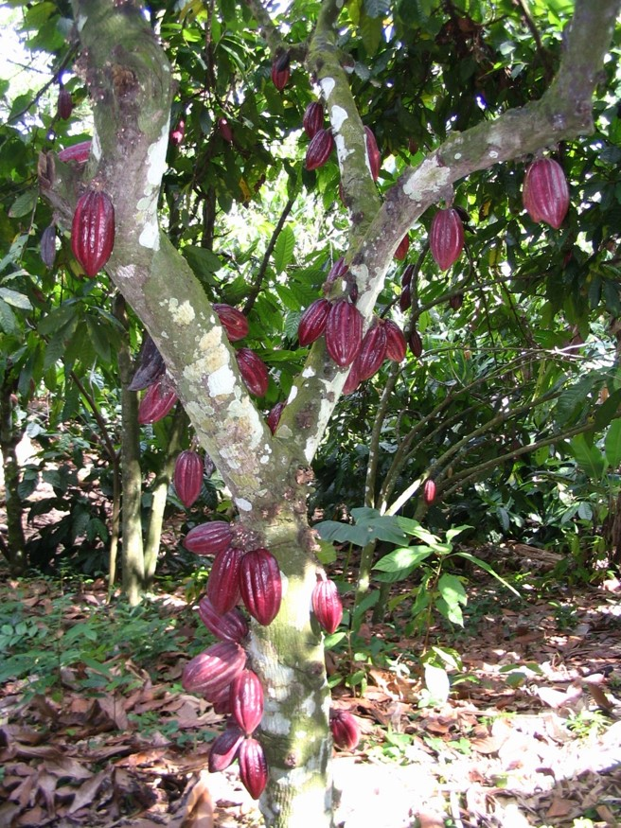

Notes:
I have a question for you all!
Who knows what plant is? It looks like something from Dr. Seuss, doesn’t it?
Does anybody know or want to guess?
[Let them raise their hands or answer]
Well, this is the plant that chocolate comes from! The chocolate that we eat so much of.
Yes, it’s true! Chocolate grows on trees. The part chocolate comes from is the pods, which are red in this picture….

Slide 3
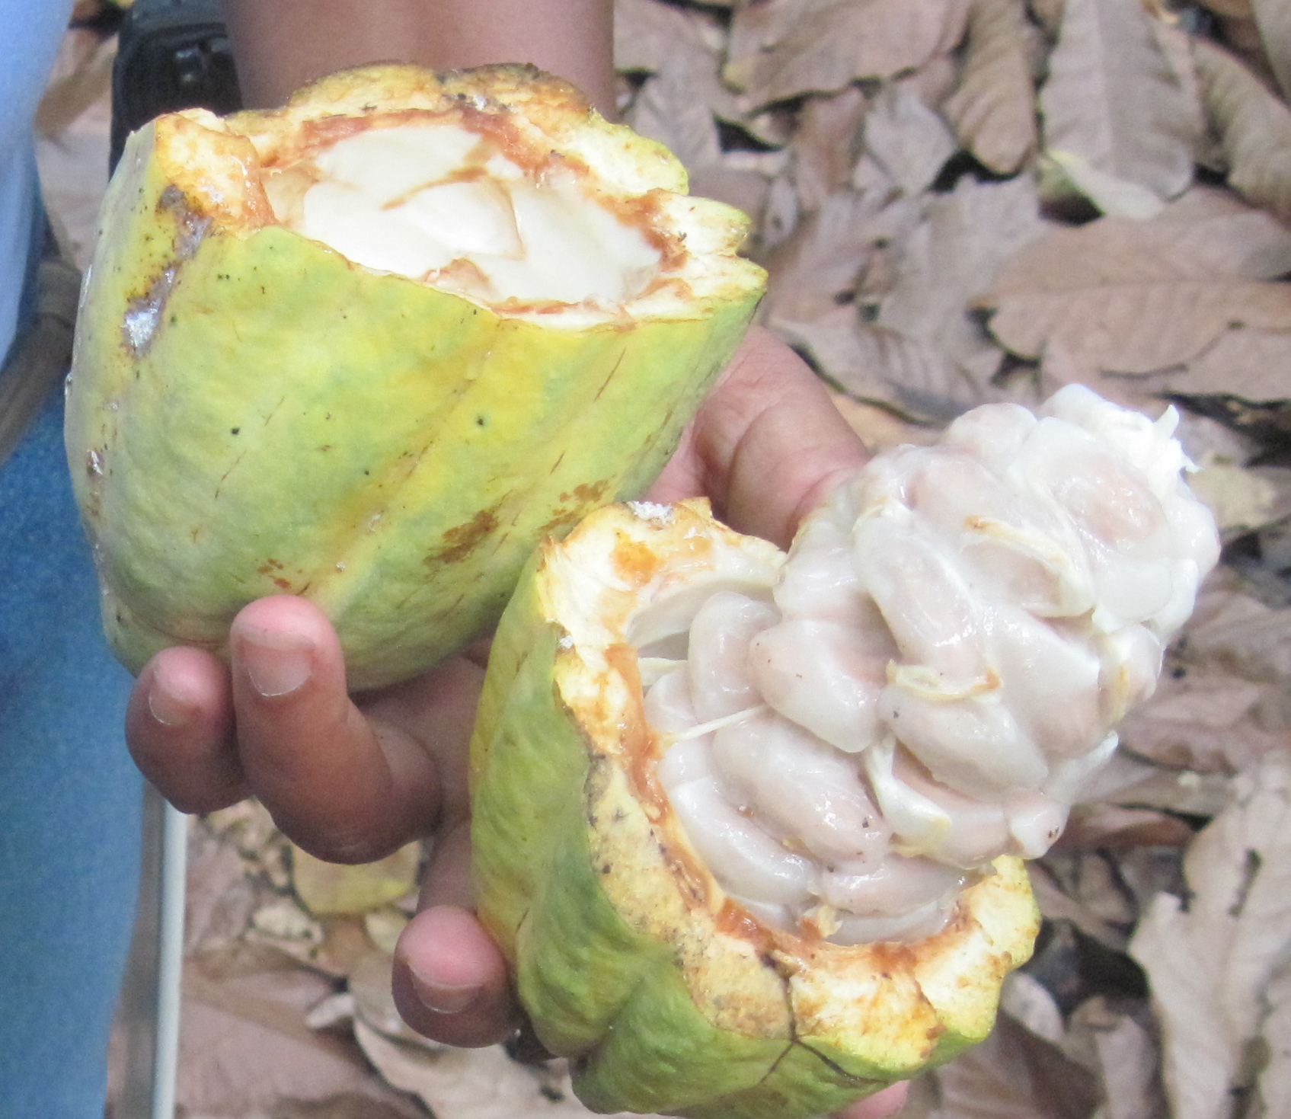
Notes:
And when the pods are open, they look like this!
That’s your chocolate, ah!

Slide 4
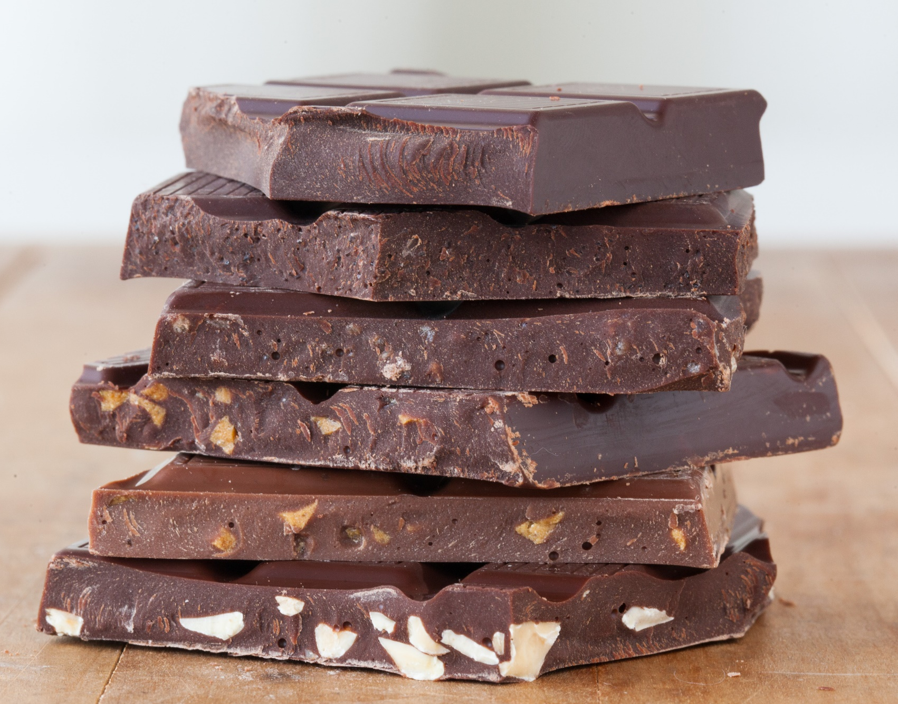
Notes:
Hmm- there’s the chocolate it’s made into! : ) Didn’t it come a long way from it’s plant?

Slide 5
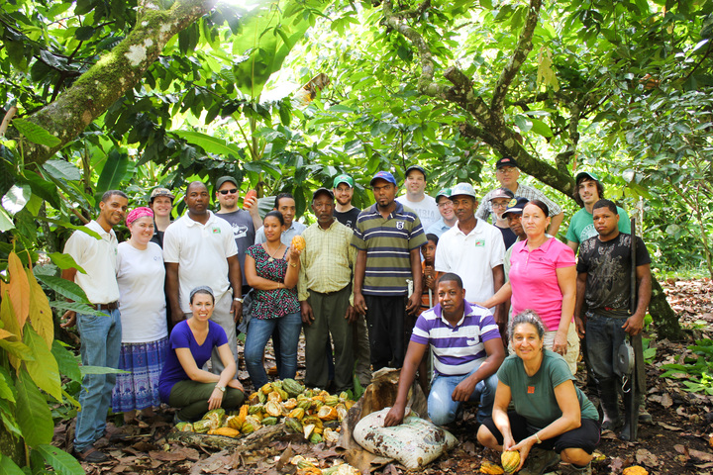
Notes:
Now that we know where our chocolate comes from, I have another question for you!
How many of you have been taught by your family to care for other people and to be nice? [let them answer]
Me too! That’s great! : )

Slide 6

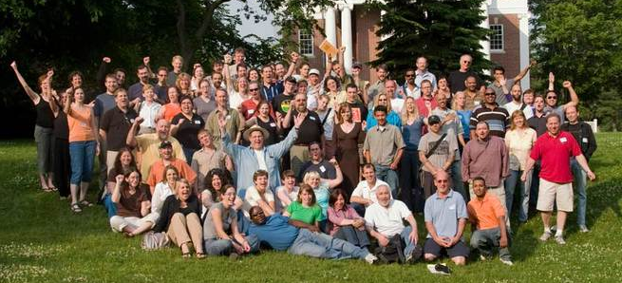
Notes:
So, as I mentioned, there is an organization called Equal Exchange.

Slide 7
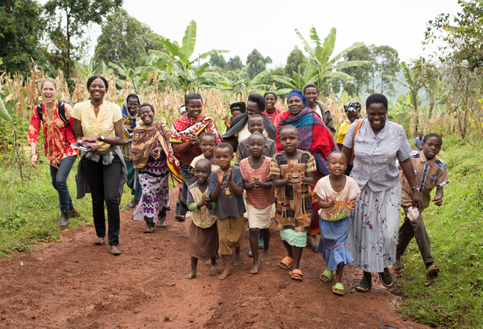
Notes:
It is a business that cares about people being treated well, especially the farmers who grow the food Equal Exchange sells.

Slide 8
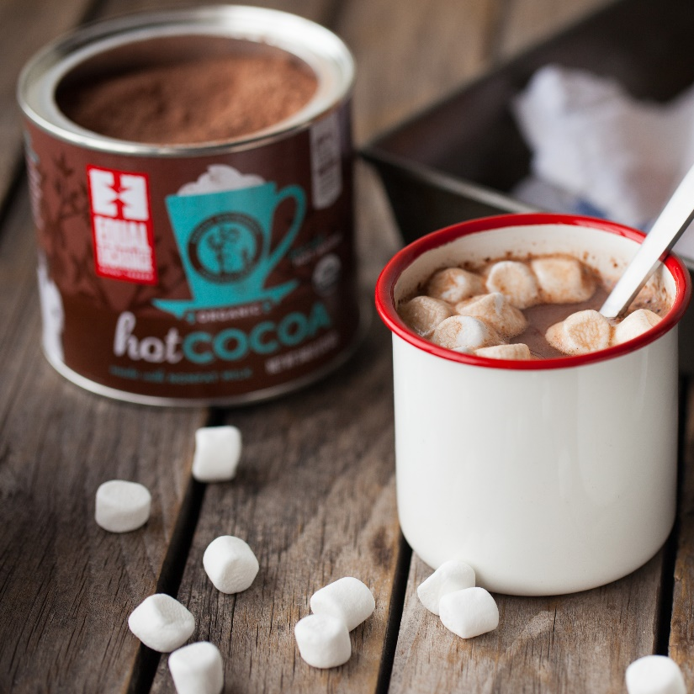
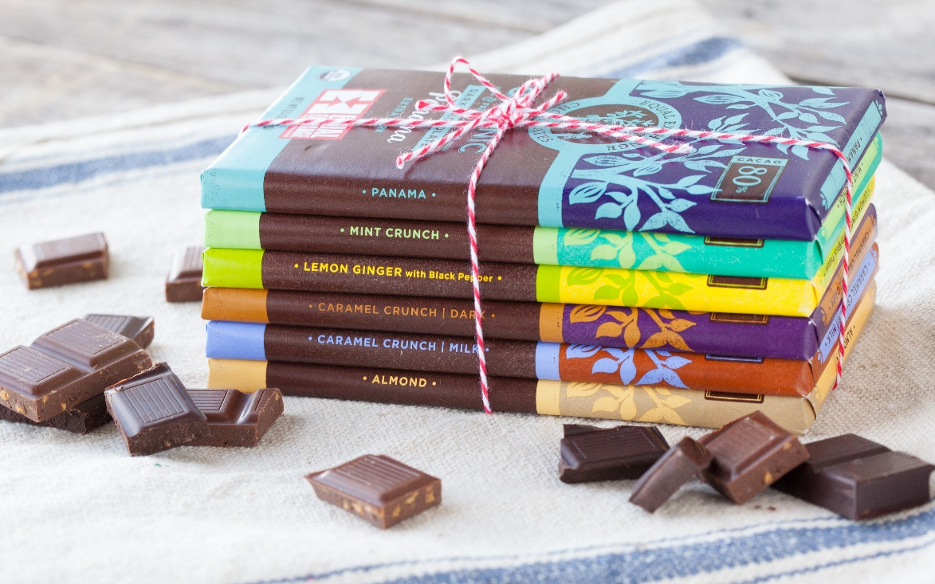
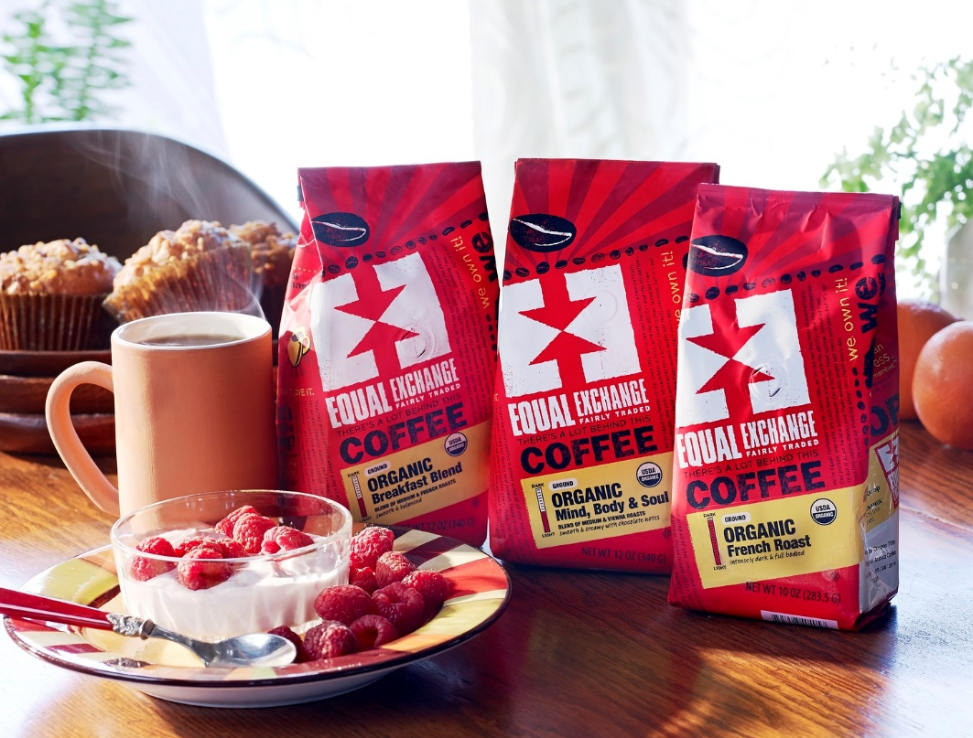

Notes:
They sell things like chocolate, coffee, tea, hot cocoa and other foods, too.

Slide 9
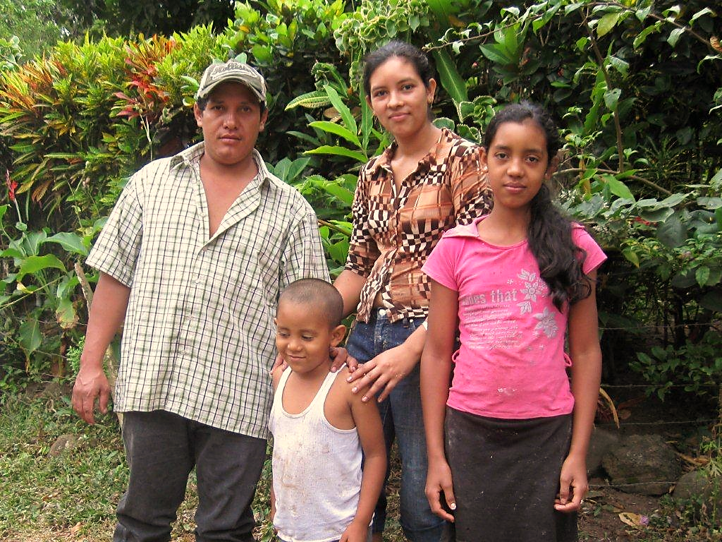
Notes:
So, what do your parents do every day while you’re at school? Someone in your family is probably working to earn money that your family lives on. With money, they can send you to school, buy food, and more.
Farmers work too! They grow plants, and sell them for money. That money helps them take care of their families.
At Equal Exchange, they buy the coffee, chocolate, tea and other foods I showed from small farmers.
Here is the Castillo family in Nicaragua who Equal Exchange buys coffee from…

Slide 10
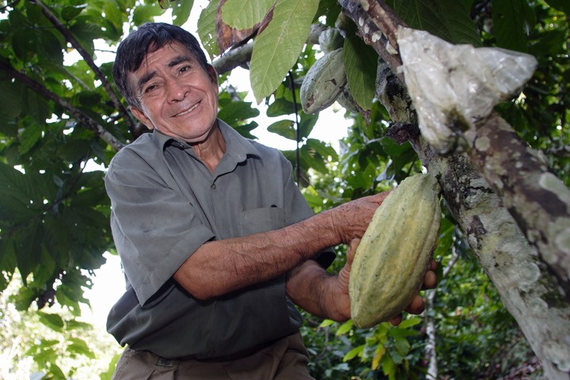
Notes:
Here is Victor in Peru who grows chocolate for Equal Exchange chocolate bars…

Slide 11
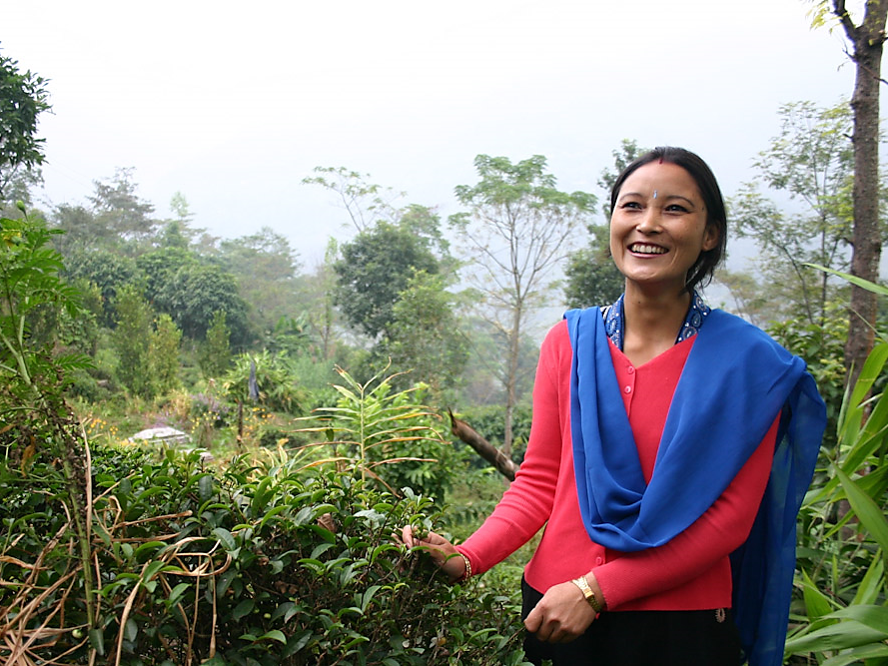
Notes:
Here’s Binita Rai growing some tea in her yard in Sri Lanka- Equal Exchange sells her tea!

Slide 12
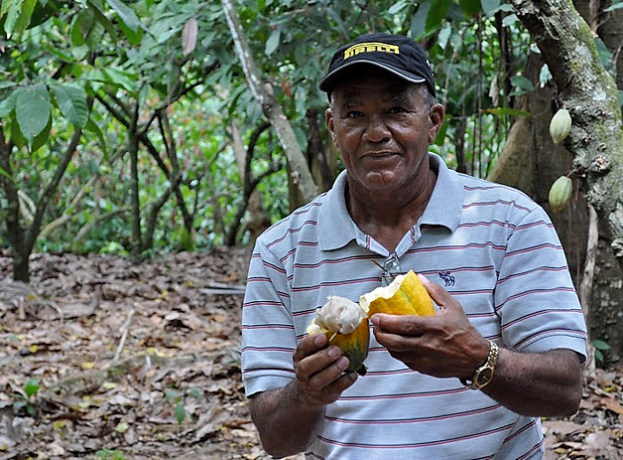
Notes:
And this is Andres Rivera-Leocadio in the Dominican Republic, who is showing us a chocolate pod here!

Slide 13
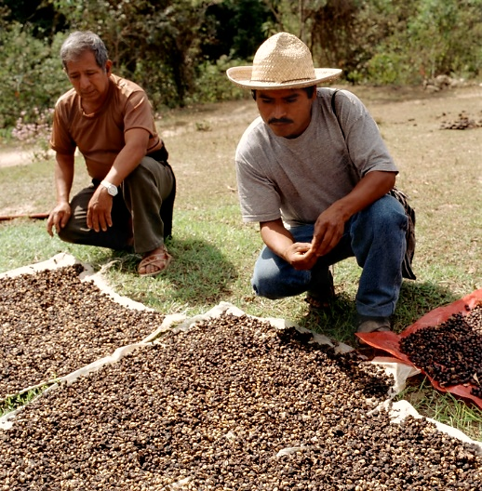
Notes:
So, why am I sharing about where your chocolate and other products come from? Why is it special? Why does it matter?
At Equal Exchange they believe that everyone, including the farmers they get their foods from that are sold to you, should be treated well. They think farmers should be paid what their crops are worth.

Slide 14
Fair Trade
Notes:
[Pause to let what they just learned sink in.]
Products at Equal Exchange are special because when you buy them, you know that the farmers have been paid well by Equal Exchange, and that they’ve treated the farmers in a fair way.
Sadly, companies often don’t treat farmers well, and don’t pay farmers what they deserve for their crops. Without being paid well, they can’t do things like send their children to school or buy enough food to eat. This is why being paid a fair price, and being treated well, is so important.
Farmers lives improve when they are paid a fair price. It is called “Fair Trade.”

Slide 15
Notes:
FOR YOUNGER KIDS: EXAMPLE 1:
(IF OLDER, USE NEXT SLIDE AND SKIP THIS ONE)
To understand what many farmers go through…
Imagine that your neighbor said they would pay money you to water their plants for a whole month. You want to buy an interesting book with that money, so you do it.
Each day you go to your neighbor’s home and water all of their plants very carefully. You do this for the entire month.
But at the end of the month, instead of giving you what you deserve, they just give you one penny. You can’t buy your book, or even a piece of gum. How do you feel?
It might feel like you worked really hard on something but you weren’t paid fairly. That is not a fair trade. This is what most farmers experience when they grow their crops but aren’t paid well for them. Companies are not paying the farmers what they earned.

Slide 16
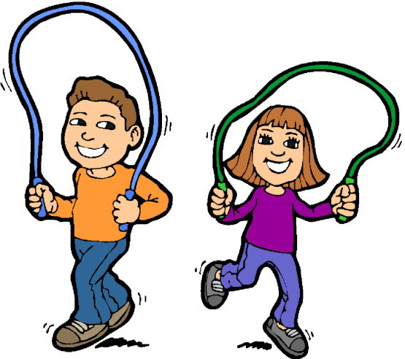
Notes:
FOR OLDER KIDS: EXAMPLE 2:
(IF YOUNGER, USE PREVIOUS SLIDE)
To understand what many farmers go through…
Imagine that your neighbor said they would pay money you to babysit their child a whole month. You want to buy what- what would you buy with that? Okay, so you want ____, so you do it.
Each day you go to your neighbor’s home and babysit a child who is sometimes screaming. You do this for the entire month.
But at the end of the month, instead of giving you what you deserve, they just give you one dollar. You enjoyed babysitting the child, but it was a lot of work and time! Can you buy your ____? No? How do you feel?
It might feel like you worked really hard on something but you weren’t paid fairly. That is not a fair trade. This is what most farmers experience when they grow their crops but aren’t paid well for them. Companies are not paying the farmers what the earned.

Slide 17
Why Unfair?
Colonialism, Post-colonialism
  Sets up plantations
  Multinational corporations grow
  Death and displacement of Indigenous peoples
  Political and economic elites
Response:
  Resistance movements
  Co-operatives
  Fair Trade movement: began in 1940’s.
Notes:
OPTIONAL SLIDE- BETTER FOR OLDER KIDS:
Why haven’t farmers traditionally been paid a fair price? Well,
Fair Trade is a way to create a more just world after a long history of oppression that has taken place since colonialism. How many of you have studied something about colonialism, or have even heard about it?
During colonialism, Europe took over other parts of the world, including Africa, South America, Latin America, and parts of Asia. Instead of respecting people who already lived there, they took over people’s land violently, and set up plantations where they didn’t treat the people working on them well. The effects of this still go on, even this many years and years later, when farmers don’t get paid well.
A response to the tragedies have been many resistance movements (esp. in Africa & Latin Am.), the formation of co-operatives to advance the interests of rural communities, and the fair trade movement.

Slide 18
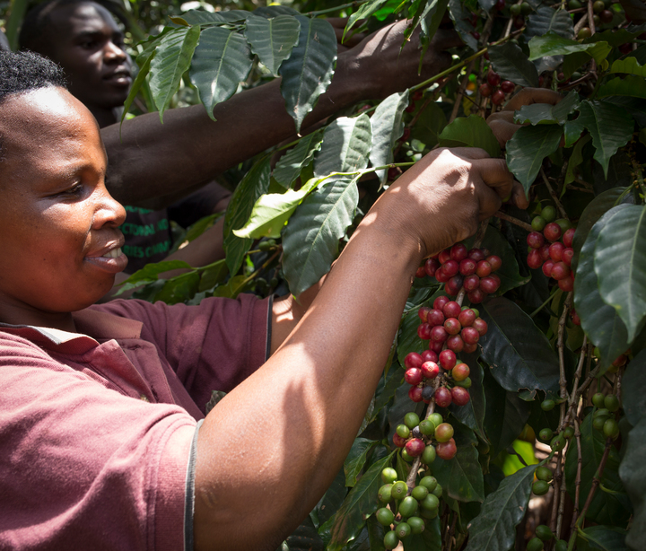
Notes:
Farmers work very hard, like this farmer from Uganda who is handpicking her coffee cherries.
It can take up to 4 years for the cherries to be ready to pick, after the coffee seed is planted!

Slide 19
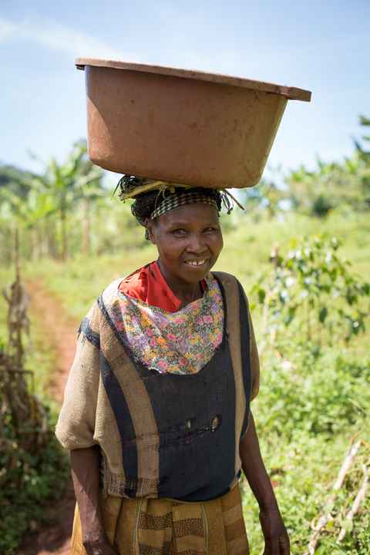
Notes:
Here is another farmer carrying the cherries back to her community. Farmers often have to walk many miles back to their homes.

Slide 20
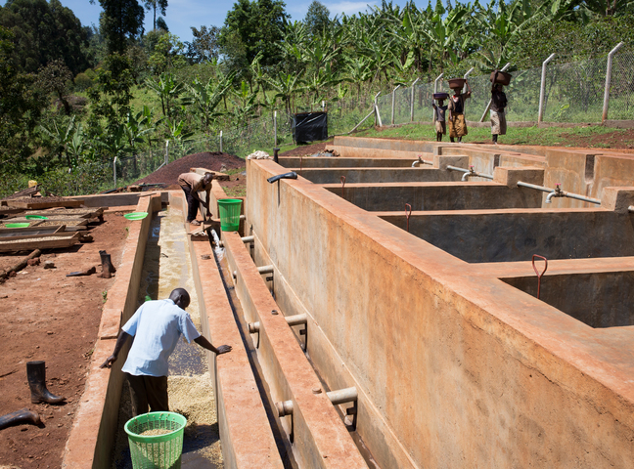
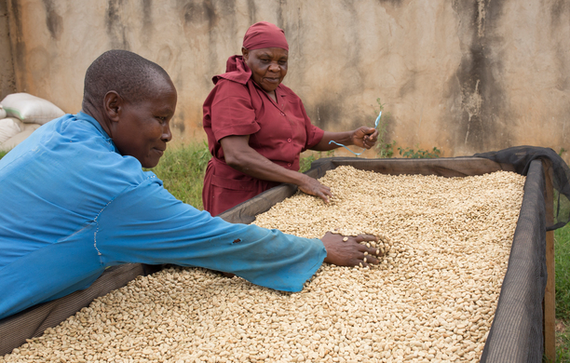
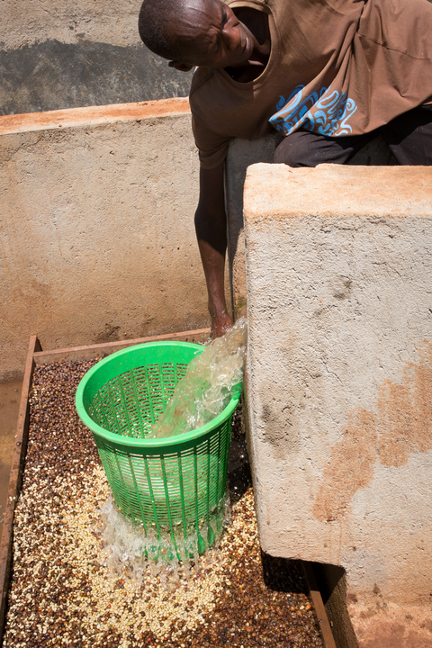
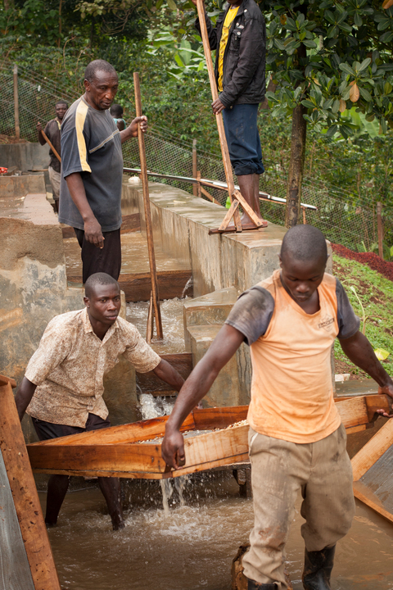
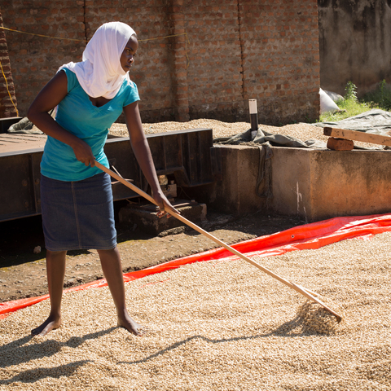
Notes:
Once they get back, they work for weeks to get their coffee in the best condition so that it will taste delicious!

Slide 21
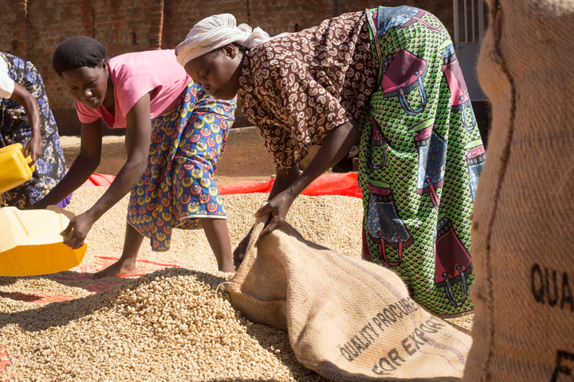
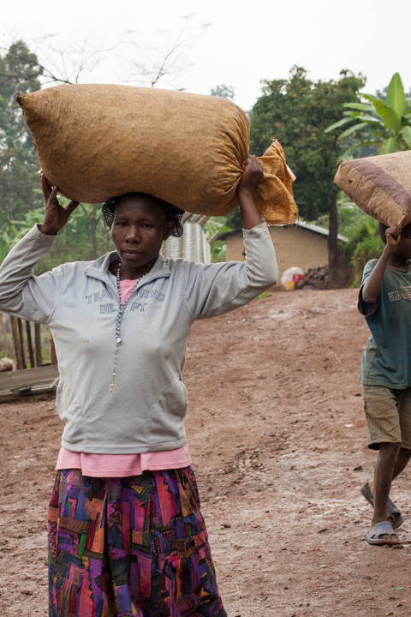
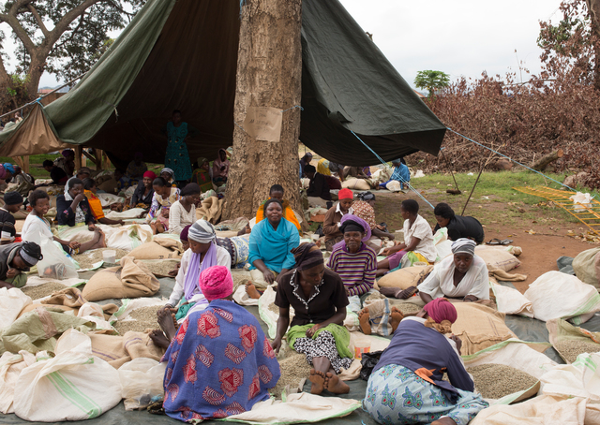
Notes:
Look at all that hard work! Don’t you think they at least deserve a fair price? I do.
It’s so unfortunate that most companies don’t pay a fair price, which is what we are trying to change.

Slide 22
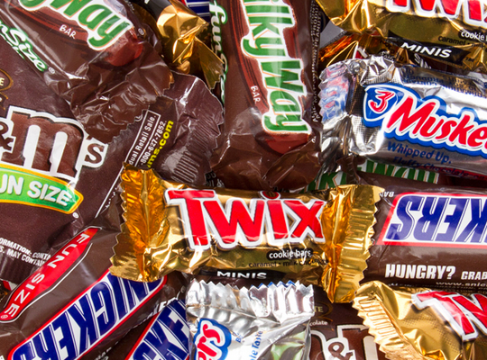
Notes:
Buying fairly traded products is especially important with chocolate because on farms where much of the world’s chocolate comes from (called the Ivory Coast), farm owners are using little boys to pick their chocolate plants.
They take the children from their families and make them work on their farm, without paying them for their hard work. Here are some children who are working on these farms:

Slide 23
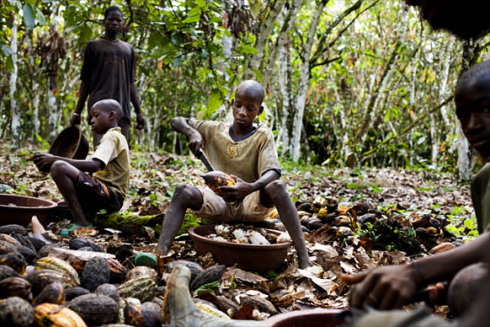
Eight-year-old twins Hassan and Hussein open cocoa pods in Ivory Coast.
Photo from CNN.com.

Slide 24
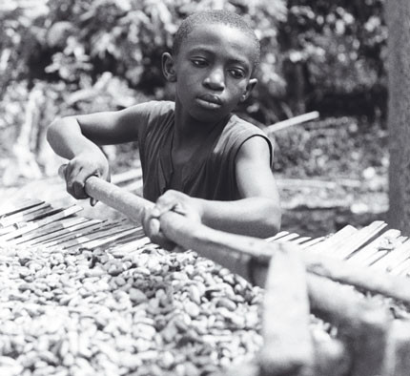
A boy spreads cacao beans out to dry.
Photo from the International Labor Rights Forum.

Slide 25
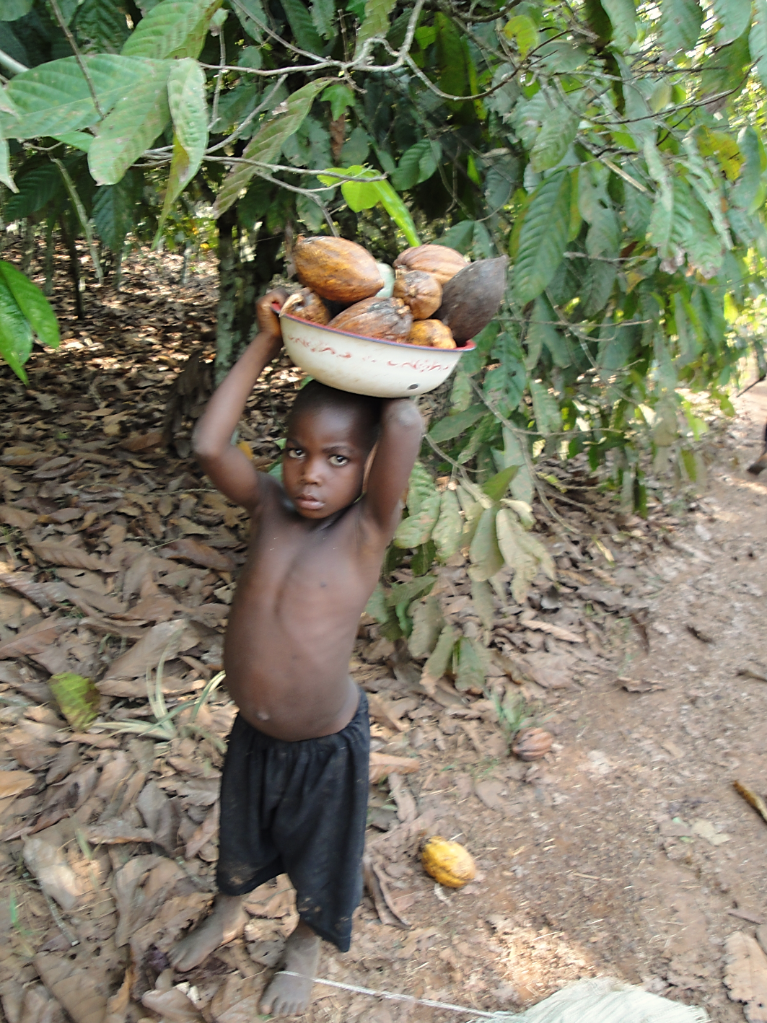
A small boy carrying cacao pods.
Photo from thefrogblog.org.uk
Notes:
What are some things you notice about these three photos?
[let answer, or answer yourself if time’s short]
[Examples: they are working, they are not at school, doing very hard work/manual labor, using dangerous tools]
You get to go to school all day, play, and go home to your families, but these kids are working on cacao/chocolate farms and don’t get to do any of that. Is that fair that they have to work on farms?
This is so sad, isn’t it? This is not the kind of world we want to create just because we want a really inexpensive chocolate bar. At Equal Exchange, they want the farmers and also children to be treated well and not suffer. So with chocolate in particular, it’s very important you think before you buy and find fairly traded chocolate.

Slide 26
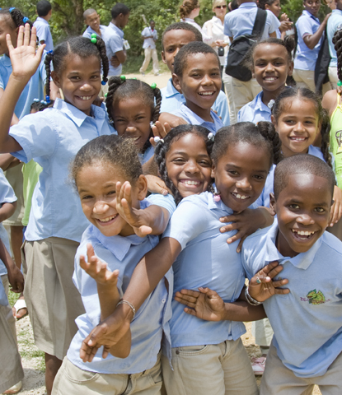
By Working Together…
Notes:
With the fairly traded Equal Exchange chocolate (you’ll sell in your fundraiser), children are not working on the farms. Here are schoolchildren from one farmer group we get our chocolate from in the Dominican Republic.
See how they are happy and in school? This is very important to myself and those at Equal Exchange. You will not find children working on the farms that make your Equal Exchange chocolate. When you fundraise with us/use these products, you know you are part of helping other children.

Slide 27

“Co-op”
“Co-operative”
Notes:
When we say that “Equal Exchange treats farmers fairly”, it also means that they pay more to both the individual farmers and to what’s called their co-op. There is the co-op symbol- those green twin pines in a circle.
It’s easy to see that paying the individual farmer more can help them rise out of poverty and have a little better life. But what does it mean to pay the co-op more, too?
Farmers we buy from work together in what’s called a co-operative, or a “co-op”. They own the co-op and make decisions together. The co-op is a way to have more opportunities and power by working together.
Through the co-op, farmers can put all their money together to buy things that would be too expensive to buy on their own.

Slide 28

Not enough money alone, but…
Notes:
To better understand how a co-op works, let’s use an example!
If you had only $1, you couldn’t afford a book that you wanted. If each of your friends also had a dollar and wanted that book, none of you could have the book.

Slide 29

₌
By Working Together
You can buy a book!
Notes:
But if you and your friends each had $1 and put all your dollars together, you could buy the book and share it. That’s how the farmer co-ops work. Farmer put their money together to buy things they couldn’t buy on their own for their families and communities.

Slide 30
Fair Trade
&
Co-ops:
People working together!
Notes:
When Equal Exchange pays farmers what they deserve, they can afford to have more things in their community. We all are working together to build healthier, happier communities around the world.
So, with money from Fair Trade and Equal Exchange, farmers can build and have things like…

Slide 31
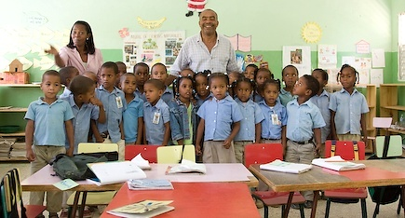
Schools
El Mogote school in Yamasa, where children of Fair Trade cacao farmers attend class.
Notes:
Co-ops and fair trade build schools…

Slide 32
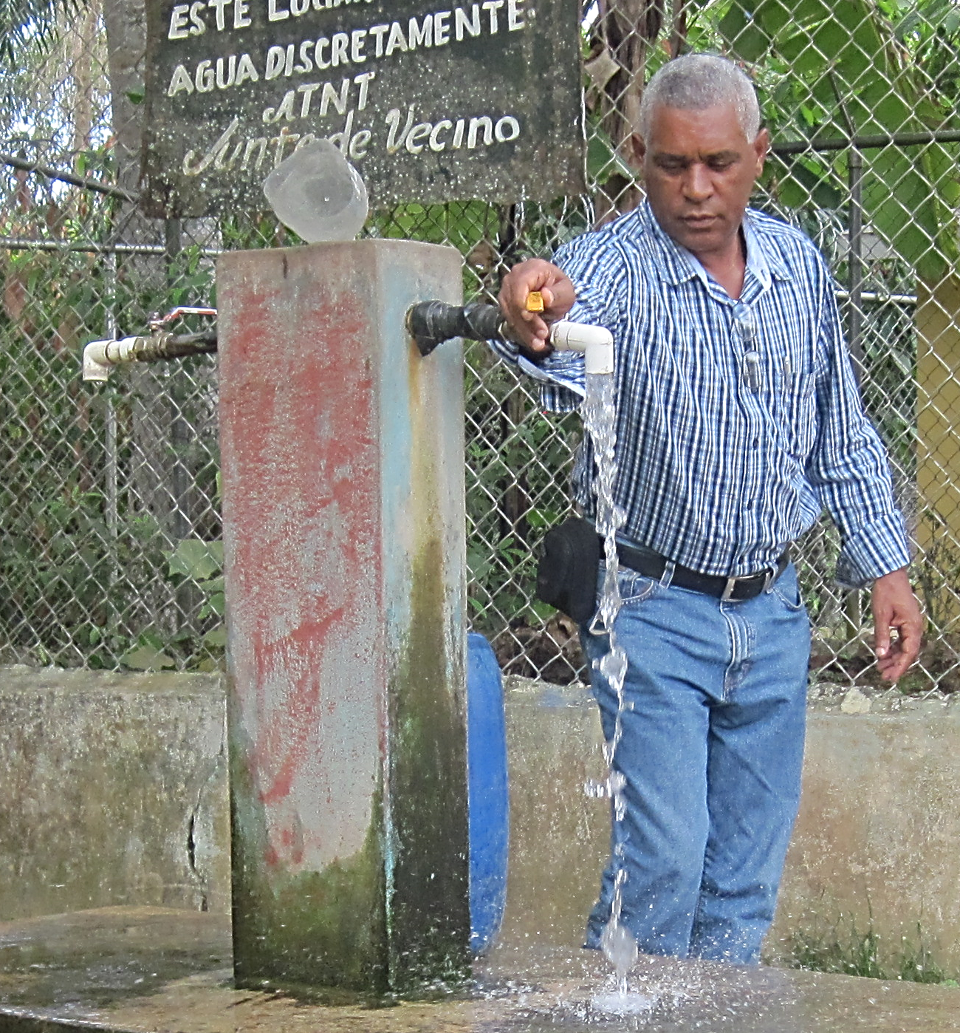
Water
Notes:
Co-ops and fair trade mean people can build water pumps to have clean drinking water near them.

Slide 33
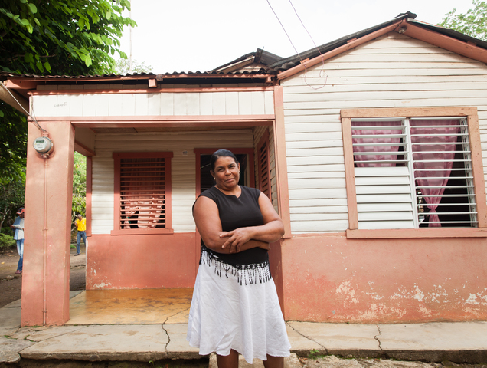
Nice Home
Good Food
Notes:
Also- a nice home with good food to eat…

Slide 34
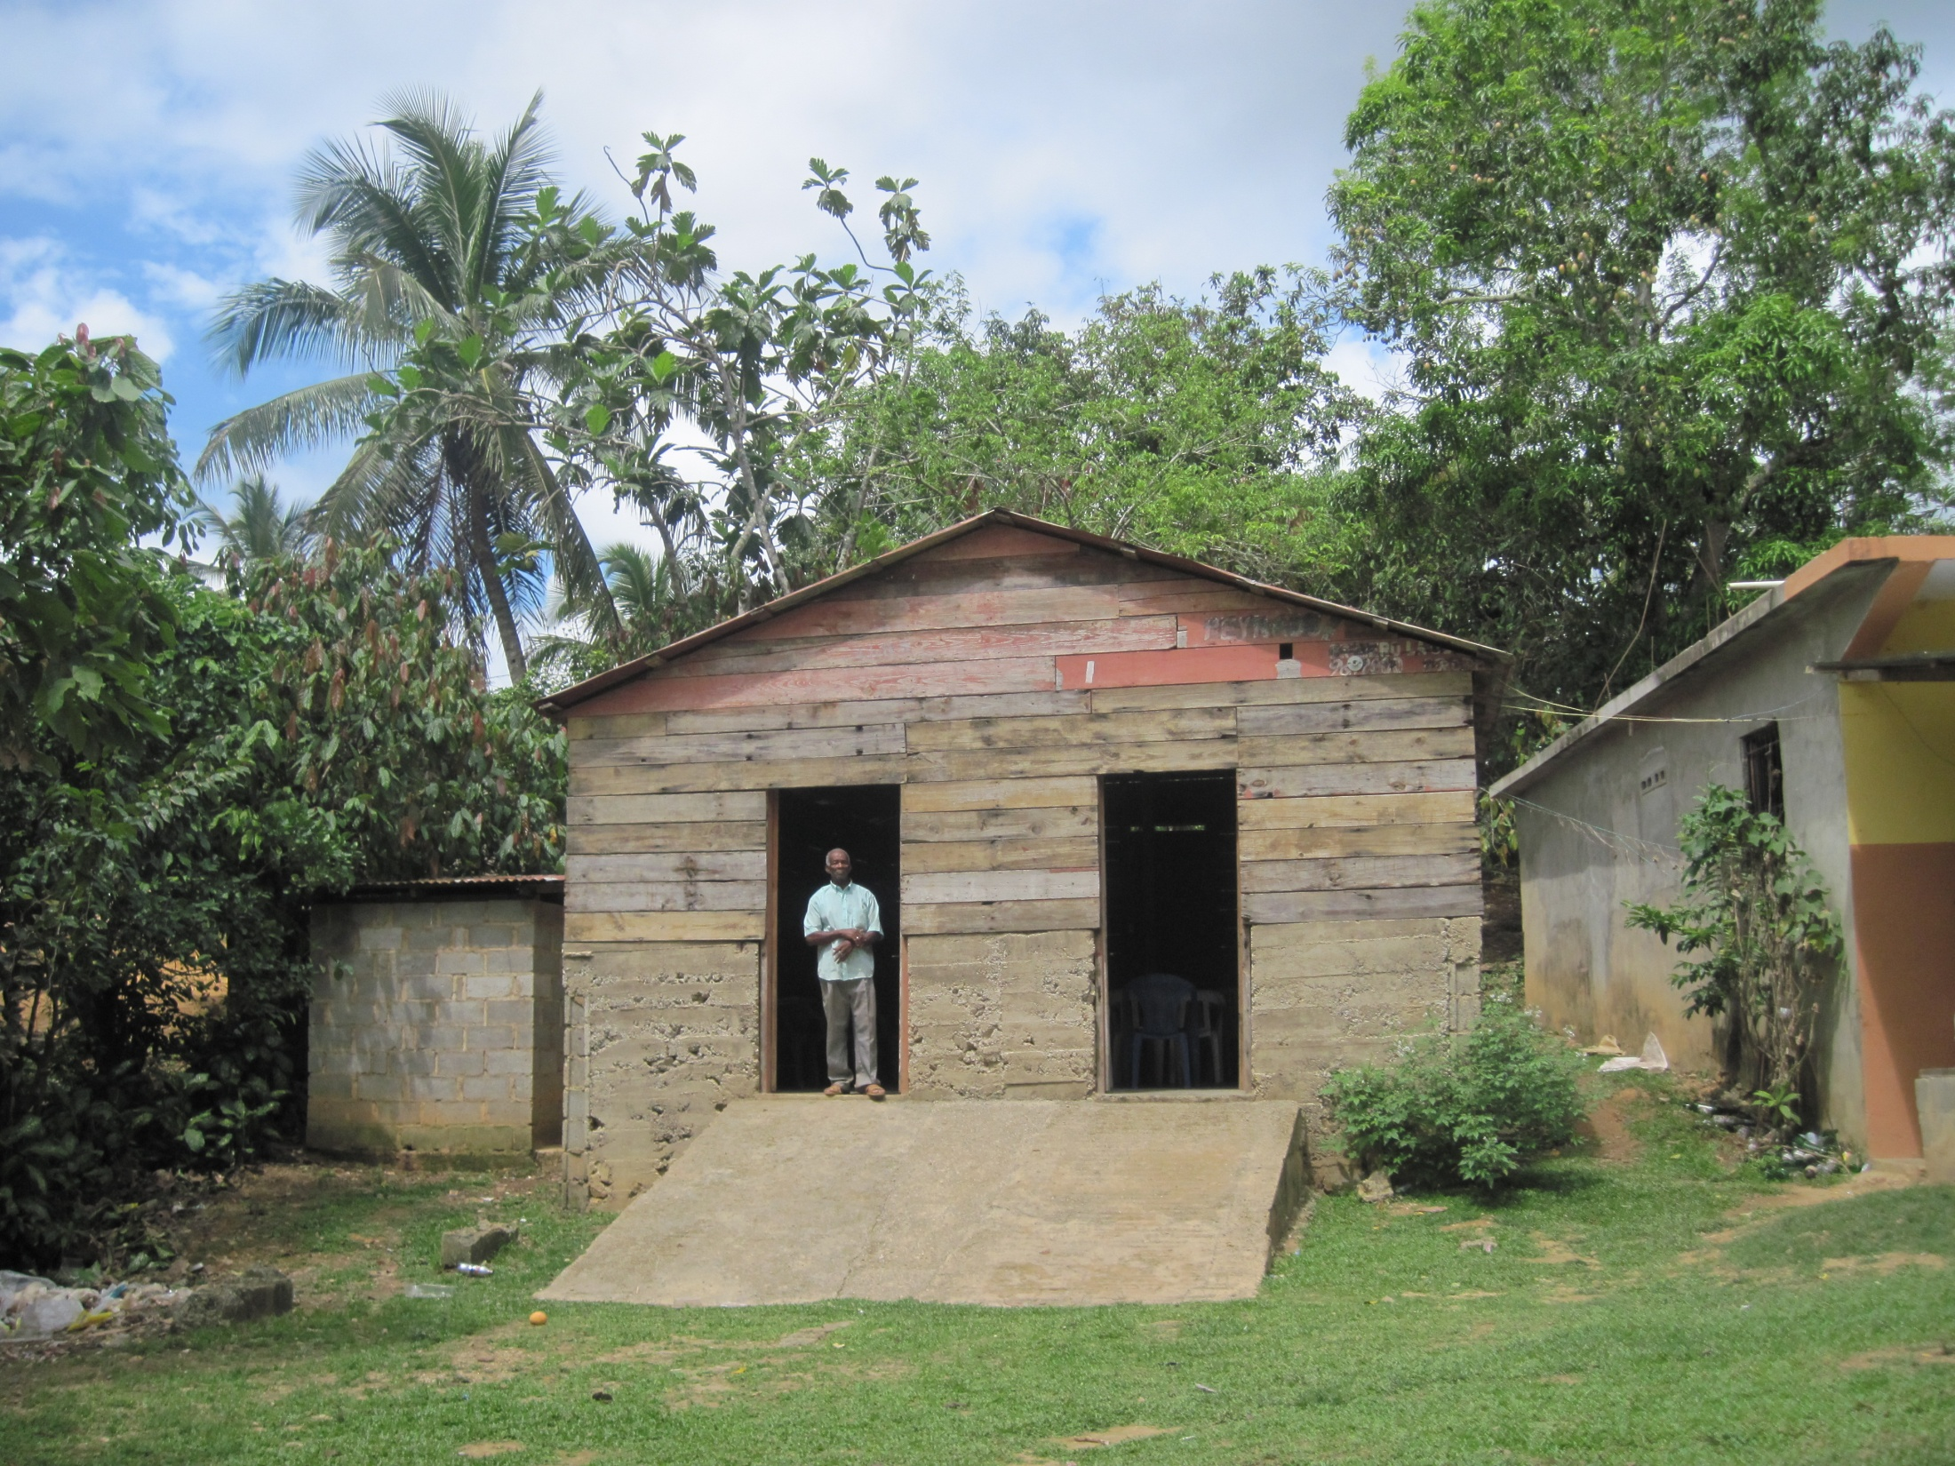
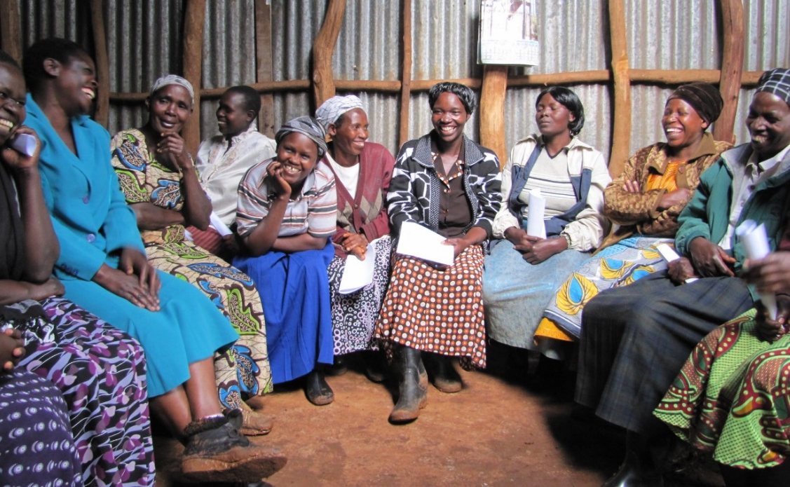
Make Decisions Together
Notes:
And people in co-ops make decisions together in places like this meeting house about things that will affect them.
Did you know that Equal Exchange is a co-op, too? There are about 100 owners!

Slide 35
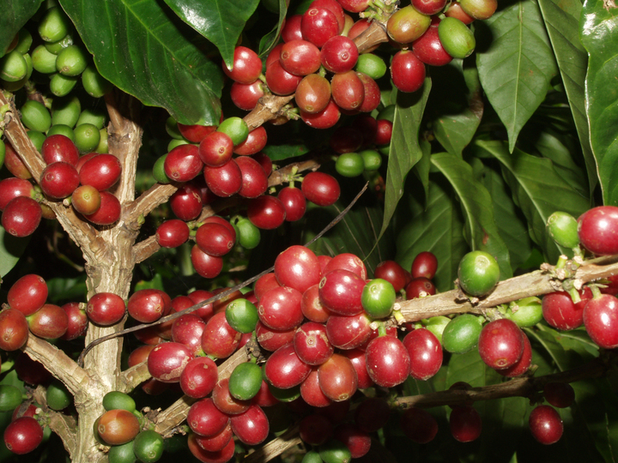
Environmental Stability
Notes:
Farmers work for a better environment.
Examples if they ask how:
-Environmental Sustainability:
-Organic farming practices that help the environment, instead of contributing to global warming
The environment and people’s well being are intertwined!

Slide 36
Most farmers don’t get paid enough, and chocolate is often grown using child labor- but these delicious products are different.
Farmers are treated and paid well.
Notes:
So, when you are fundraising with Equal Exchange, or if you see Equal Exchange products, you can let people know that:
Most farmers don’t get paid enough, and chocolate is often grown with child labor- but these delicious products are different. Farmers are treated and paid well.

Slide 37
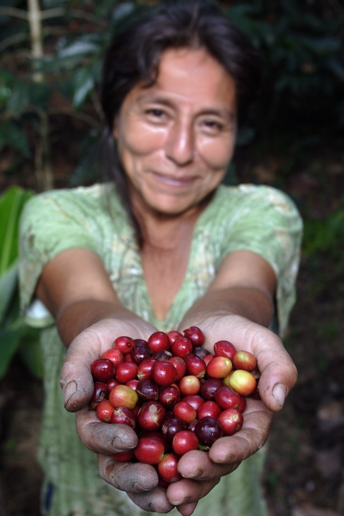
Notes:
So… from the farmer who is planting their first seed,

Slide 38
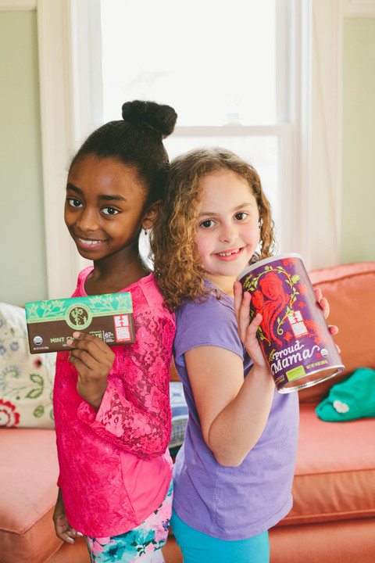
Notes:
To your fundraising work with us at Equal Exchange,
OR
To your buying and sharing about fair trade and Equal Exchange,

Slide 39
Let’s make a difference!
Notes:
Together we can make a difference! Together we can create a world where children and families are happy and treated fairly.
Thank you. Any questions?

