Slide 1
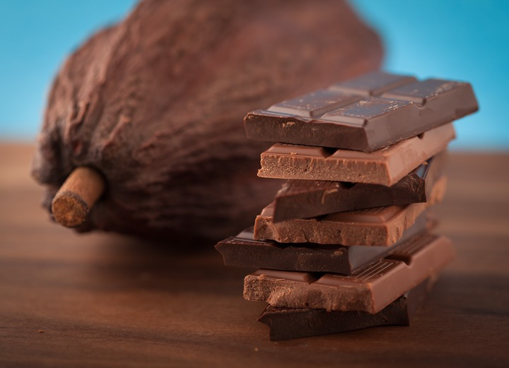
Fair Trade Chocolate
Orientation & Tasting

Slide 2
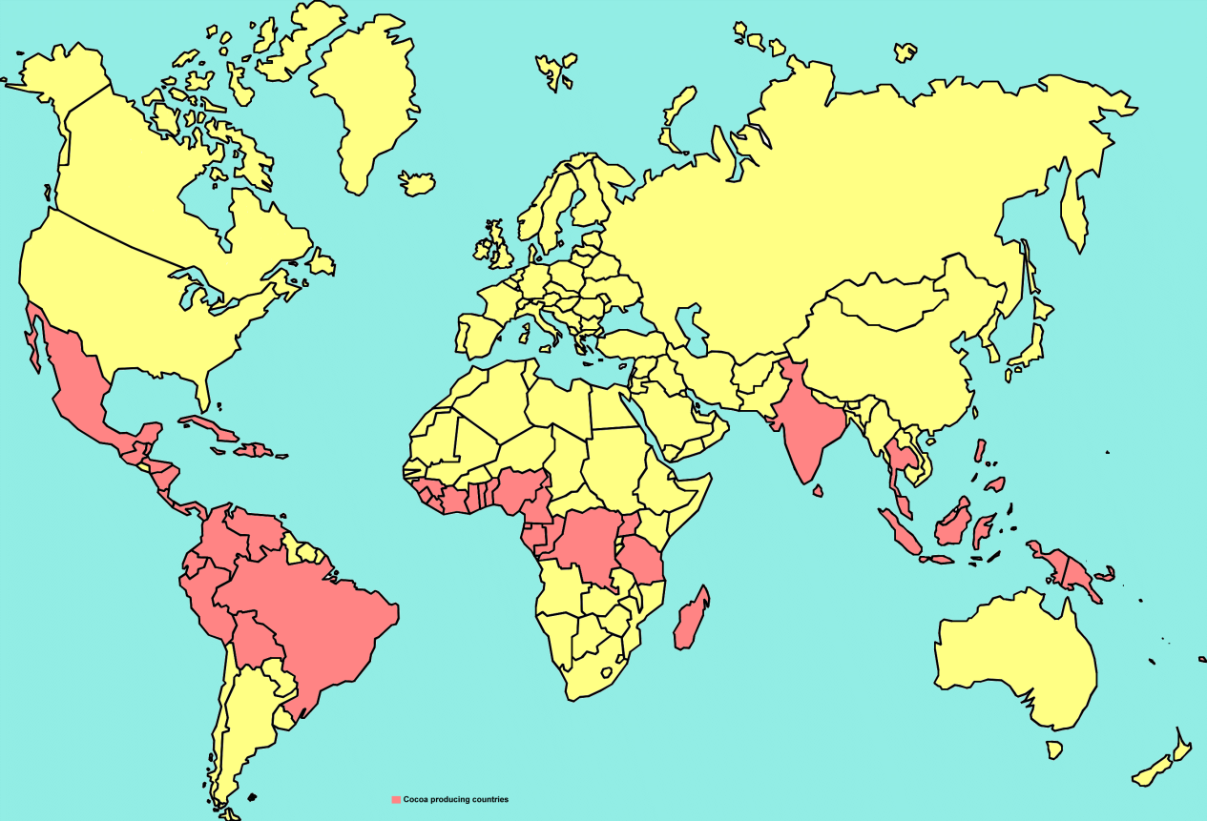
Cacao Production
Cacao is grown in over 50 countries located near the equator
Notes:
Like coffee, only certain climates are conducive to growing cacao. “Cacao” is the name of the agricultural product– chocolate is the finished product. “Farmers grow cacao trees on small farms in tropical environments, within 15-20 degrees north and south of the equator.” World Cocoa Foundation

Slide 3
Top Cacao Producing Regions
Notes:
World Cocoa Foundation, April 2014
The largest producing country by volume is Côte d’Ivoire, which produces 33% of global supply.
Equal Exchange purchases cacao from the Dominican Republic, Peru, Ecuador & Panama (in the 15% group of global production). These countries were chosen to give market access to farmers who would not have it otherwise and because they are democratically organized into cooperatives, use organic farming techniques and grow high quality cacao.

Slide 4
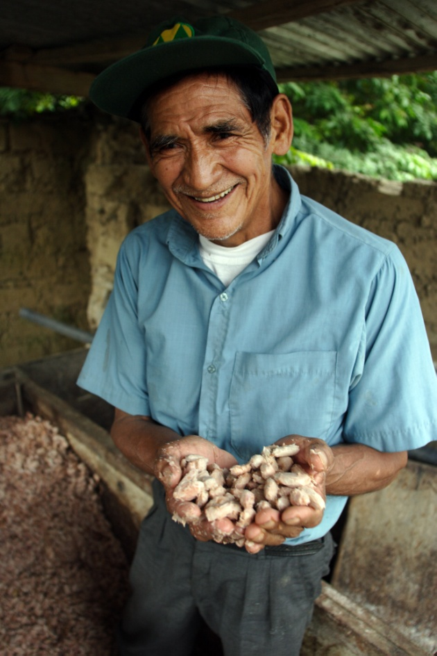
World Cacao Production
80 - 90% of the world’s cacao production comes from 5-6 million small-scale farmers
Main source of family income
Labor-intensive farming methods
Don Luis Diaz Aylas, CACVRA, Peru
Notes:
Source - (World Cocoa Foundation, April 2014), Cocoa Barometer 2012 (latest report)

Slide 5
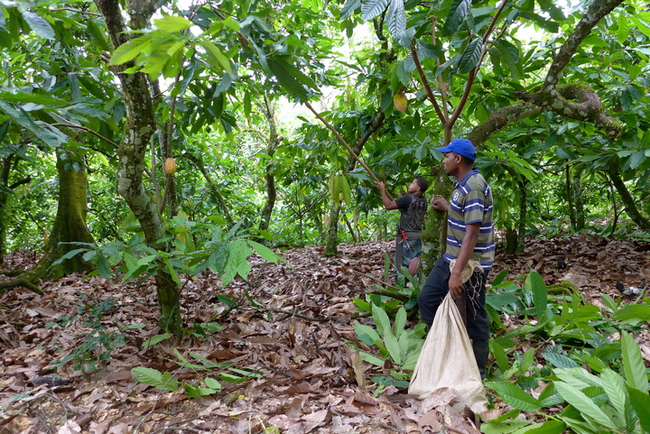
Notes:
Cacao trees thrive in a tropical climate: 70-89°F, humidity of 65-70% or higher, and need a lot of consistent rain and shade.
Trees begin producing at 5 -6 years.
“With proper care, most cocoa trees begin to yield pods at peak production levels by the fifth year, which can continue for another 10 years.” World Cocoa Foundation
Photo Conacado D.R., 2013

Slide 6
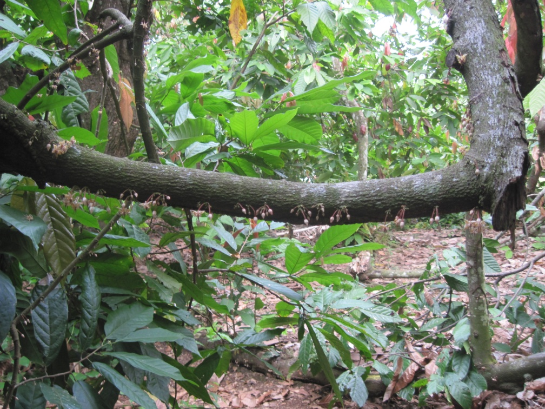
Notes:
Of the hundreds of tiny white flowers that sprout from the tree, only a small percentage will become cacao pods.

Slide 7
Notes:
A close up photo of the flowers and a newly forming cacao pod.

Slide 8
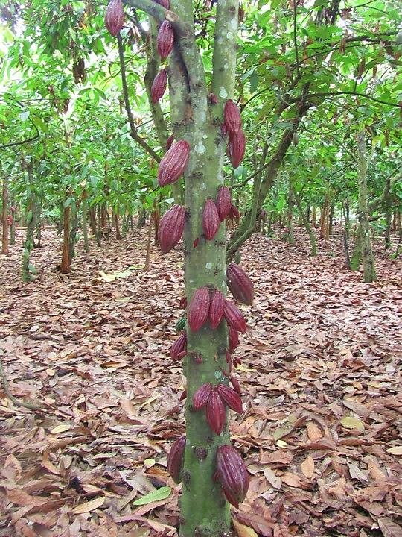
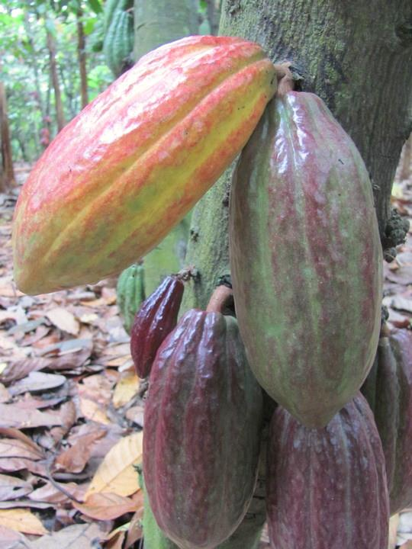
Notes:
Cacao pods, the fruit of the tree, grow from the trunks and branches of the tree.
Photos from Ecuador

Slide 9
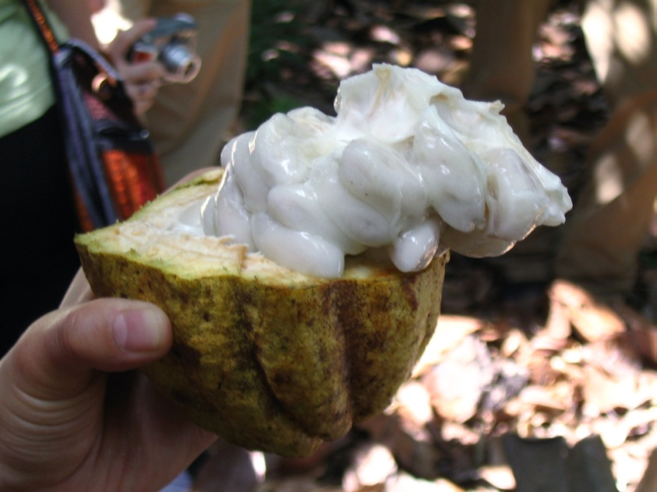
Inside the pods are the cacao beans – almond-shaped and surrounded by a sweet, white pulp. There are about 50-60 beans/pod.
Notes:
Pass around dried cacao pod if you have one. Shake it to hear the beans rattle around inside.
You can purchase one from Equal Exchange http://shop.equalexchange.coop/dried-cacoa-pod.html

Slide 10
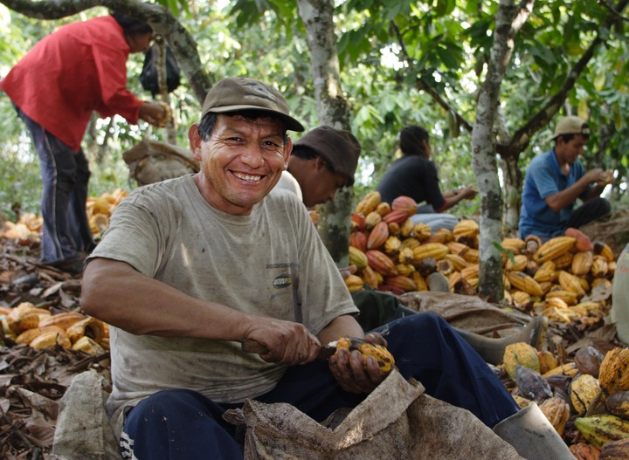
Once ripe, pods are cut down and sorted on the farm.
.

Slide 11
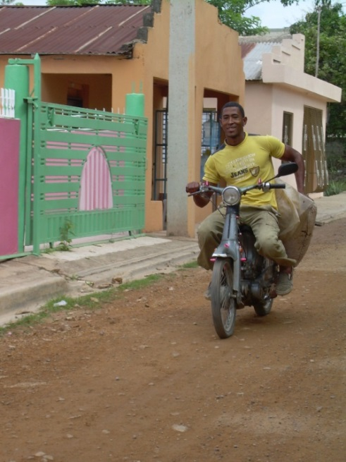
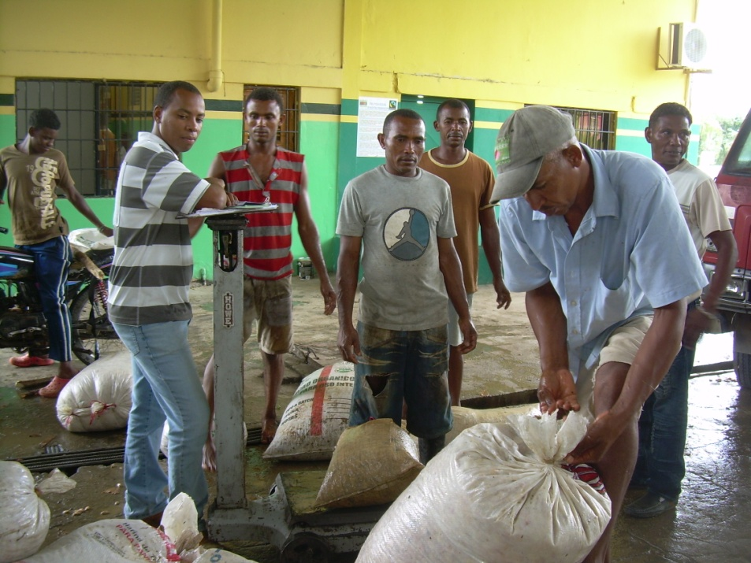
Beans are either processed at the farm or at a central processing facility, like at CONACADO in the Dominican Republic.
Notes:
Beans are processed and transported to their next steps…fermentation and drying

Slide 12
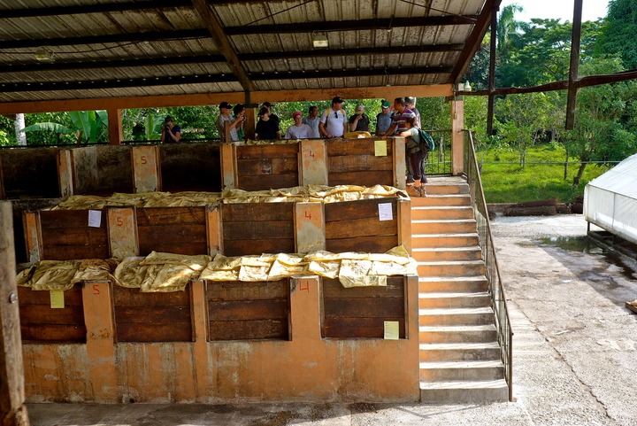
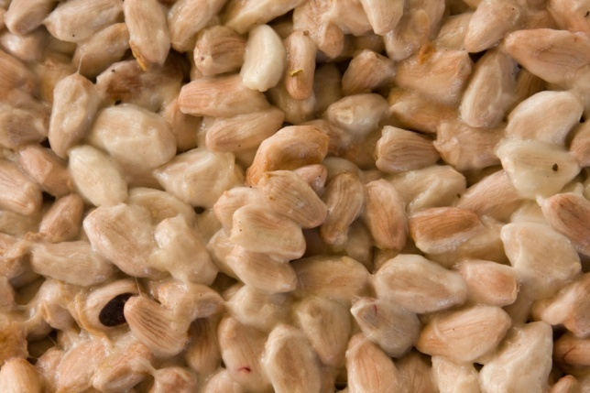
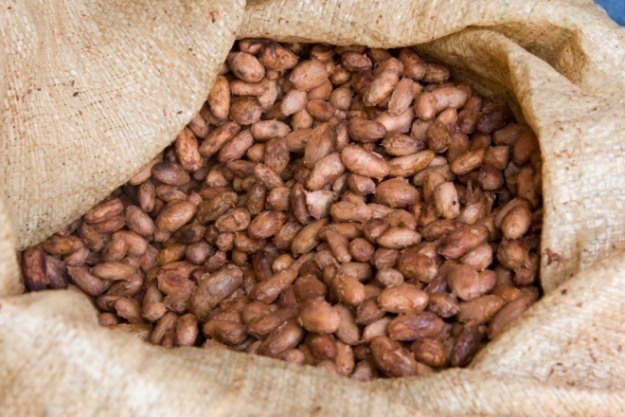
Before:
After:
The fermentation process transforms the flavor to what we associate with cocoa and chocolate.
Notes:
Fermentation takes approximately 5 – 7 days
Fermented to remove the pulp/mucilage, stop the bean from germinating, and to begin flavor development
Phase 1 of cocoa fermentation (anaerobic): sugar + yeast --> alcohol + carbon dioxide + heat Phase 2 of cocoa fermentation (aerobic): alcohol + bacteria + oxygen --> acid + water + heat
Complex chemical changes to take place in the bean such as enzyme activity, oxidation and the breakdown of proteins into amino acids. These chemical reactions cause the chocolate flavor and color to develop.

Slide 13
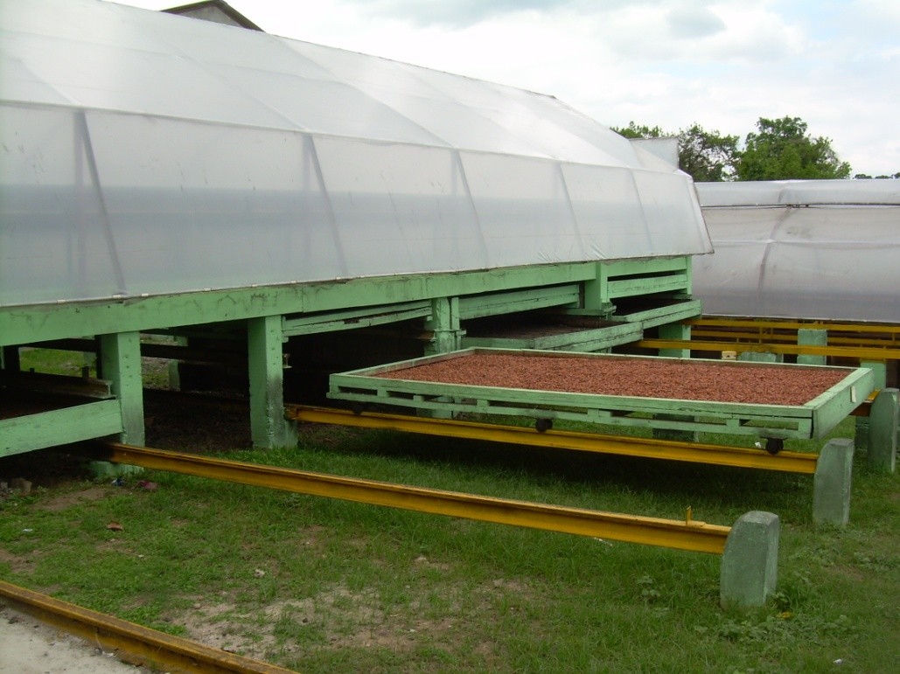
Cacao Production - Drying
Drying beds at CONACADO in the Dominican Republic, an investment made possible in part by Fair Trade premiums.
Notes:
Sometimes drying takes place on a smaller scale. The CONACADO cooperative in the DR used money from Fair Trade premiums and pooled their money to buy and share this and other processing equipment.

Slide 14
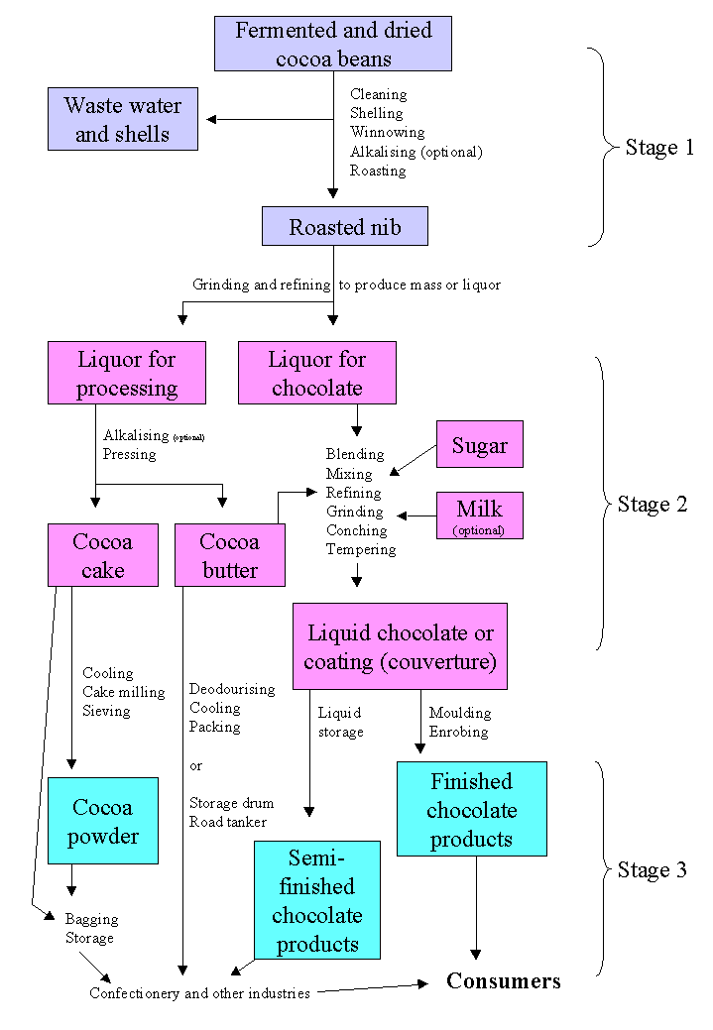
Notes:
Processing:
Equal Exchange chocolate bars are made in Switzerland; chocolate chips are made in Peru
Play 4 minute “How Cocoa is made” Video if there is time
https://www.youtube.com/watch?v=JiK2XqcuI7I&t=164s
Key:
Winnowing = removing shell
Alkalized/Dutched = process, using an alkali , that darkens cocoa, reduces acidity and makes it more dispersible (only for EE cocoa based products).
Conching = kneads, aerates and mixes chocolate for up to 3 days between 140-167˚F, which improves texture and removes acidity. (Many companies use soy lecithin to cut down on conching time and cost)
Tempering = cooling process which ultimately brings chocolate down to about 104˚F and creates uniform crystals within in the mixture.
Stage 1: Grinder
Stage 2: Chocolate Manufacturer
Stage 3: Molder/Retail Brand

Slide 15
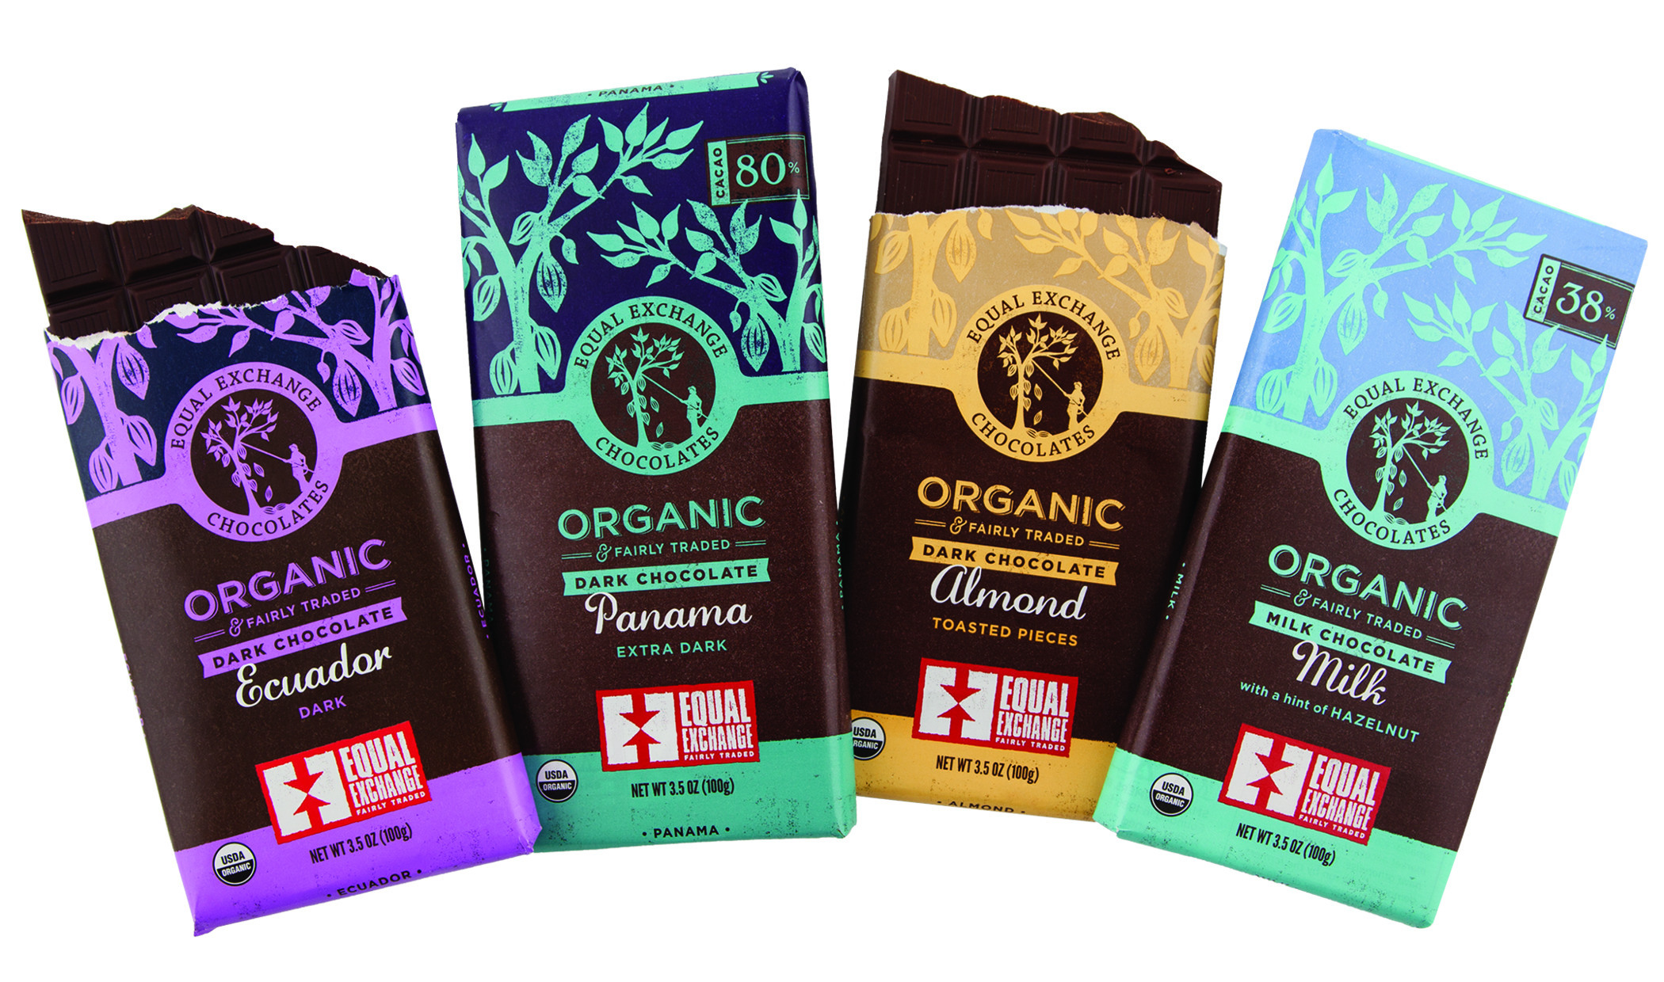
Equal Exchange vs other chocolate brands
Always Small Farmer Grown
Fair Trade floor price to farmers when the market is low
Premium to the co-ops that is paid above market prices
Market access and additional collaboration with farmer co-ops
Notes:
Equal Exchanges believes that democratic, small farmer co-ops are key to creating sustainable change and that they’re the heart of authentic Fair Trade.
Not only is the cacao is Fair Trade, but also our sugar and vanilla. Sugar comes from Paraguay and vanilla from Madagascar.
Our goal is always 100% Fair Trade ingredients in our products, but when that isn’t possible due to the complexities of multi-ingredient products, we still strive for as much Fair Trade content by weight as possible. Look on your chocolate bar wrapper’s ingredients label for the percentage of fair trade content.
Think about the first ingredient in many other brands of chocolate bars you see…most of the time it’s sugar. Even if these bars have a fair trade certification label, it is likely only the fair trade certification only applies to the cacao inside – check the other ingredients listed and compare that to the percentage of fair trade content. If it’s not listed – check with the manufacturer - if they don’t use fair trade ingredients, ask them why not.
Chocolate bars also have different percentages of cacao inside. If you know the percentage of cacao, this also tells you what percentage is other ingredients. The higher the cacao percentage, the darker the chocolate and more actual cacao is inside. Equal Exchange’s Ecuador Dark Bar is 65% cacao but we make dark chocolate all the way up to 88% cacao called Extreme Dark. Milk chocolates will have significantly less cacao content because the majority of the bar isn’t cacao.

Slide 16
Fair Trade Cocoa –
Stable & Better Price
Fair Trade Price:
Floor Price = $2,000/metric ton
FT Premium = $200/metric ton
Organic Premium = $300/metric ton
FT Organic Price = $2,500/metric ton
*If the conventional market price goes over $2,000/mt the fair trade price must go at least $200 over the conventional market.
Notes:
The Market fluctuates and there are high and low prices of agricultural products which affects farmers’ livelihoods directly. Fair Trade ensures that farmers are always paid a floor price, regardless of how the market changes. Equal Exchange also provides farmers with pre-harvest financing so they are paid in advance to cover some of the costs associated with production and don’t have to wait until after the harvest.

Slide 17
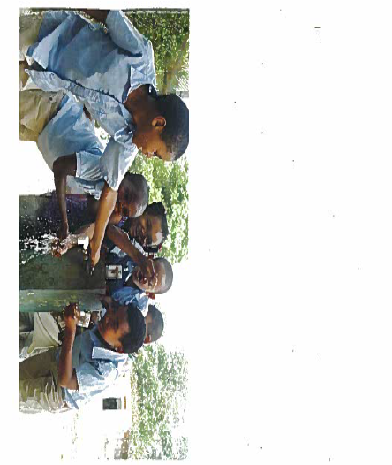
Fair Trade social premiums go towards community projects
Notes:
How do farmers use their social premiums? In San Rafael, a small community of Cacao farmers in the Dominican Republic countryside previously had to travel at least 3 miles to get clean water from a river and transport it back on a donkey.
Using Fair Trade social premiums from their cacao harvest the community came together to dig a 12 mile trench from a freshwater spring in the mountains. Now clean drinking water runs to every house hold.

Slide 18
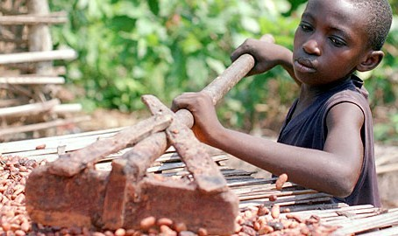
Ethical Issues and Chocolate
Estimated 500,000 to 1.5 million child laborers in Ivory Coast and Ghana
Low prices for cacao makes it almost impossible to pay for hired labor.
Corporate and consumer demand for cheap chocolate products, lack of transparency in corporate cocoa sourcing and practices, industry consolidation and politics all contribute to the problem.
Notes:
According to the US State department 109,000 children work in the cocoa industry. Other reports estimate that there are 500,000 to 1.5 million child laborers in the cocoa sector of Ivory Coast and Ghana alone, countries which produce over 70% percent of the world's cocoa (International Labor Rights Forum 2016 report)
Many cocoa farming families in Ivory Coast and Ghana make roughly $2 per day making it difficult for them to pay hired laborers to harvest the crop fueling the need for child labor
The demand for cheap chocolate products, lack of transparency in corporate cocoa sourcing and practices, industry consolidation and geopolitical issues all contribute to the problem.
Fair Trade is different:
Must follow International Labor Organization Conventions (forced labor, minimum age). They have created specific standards and audit tools to conform to these standards
Worst forms of child labor are considered a major non-compliance and a co-op will be immediately suspended
What can you do to create change? Be sure to buy only fair trade chocolate. Ask questions and demand supply chain and wage transparency from large chocolate companies.

Slide 19
Any questions?
Notes:
This is the Equal Exchange chocolate team – they source the cacao and work with famers on problem solving and productivity, taste and assess quality, keep product consistency within a specific taste profile and develop new flavor combinations.

Slide 20
Tasting Chocolate
Notes:
In addition to it being delicious - there’s actually a science to tasting chocolate. There are professional chocolate tasters and graders. Similar to wine and coffee – cacao is an agricultural product so there can be many different flavors to be distinguished in chocolate based on where and how it’s grown.
Choose 3 or 4 kinds of chocolate. Start with milk chocolate and work your way up to the higher cacao percentages. Try chocolate with and without inclusions like mint, caramel and sea salt and orange. Guide the group with the next slide and go step by step for each type of chocolate. Visit http://equalexchange.coop/ee-and-you/fundraising/chocolate-can-be-delicious-and-educational for additional resources like a downloadable chocolate tasting place mat.

Slide 21
Appearance: Does it shine? Is it blemish free?
Aroma: This hints to what’s inside.
Snap: Is it a clean, crisp snap?
Flavor: Sweet, Sour, Salt, Bitter; and aromatics
Aftertaste: How does it taste after you swallow? Is it pleasant? Does it linger?
Notes:
Appearance: First take a look at your chocolate. Is it glossy and smooth? Is it discolored? Does it have pit marks? A good quality chocolate will have a glossy shine. It will have a consistent color and a smooth surface, both of which are signs of the quality of the chocolate-making process
Aroma: Before eating your chocolate make sure you smell it. The aroma of chocolate often gives hints of what flavors you will experience once you bite into the chocolate. Is it pleasant? Do you smell something sweet or floral; or is it musty or smoky? Chocolate is a complex food that can have many aromas and flavors.
Snap: How the bar breaks is often an indicator of the quality of a bar. A well-made, high cacao content bar should produce a loud, clean snap when broken in two.
Flavor: Now it's time to eat! Take a bite of the chocolate, chew it several times and move the pieces around your tongue and mouth. Let the pieces sit and slowly melt on your tongue. What flavors appear? Can you taste any of the four basic tastes (sweet, sour, salt and bitter)? Do you taste any aromatics - the flavors beyond the four basic tastes - such as fruits or nuts? Is it earthy, or do you get a roast flavor? A good chocolate will have different flavors that appear throughout the bite. It is important that the flavors are both pleasing and well balanced so that one flavor doesn't overpower the others.
Aftertaste: What flavors are left on your tongue a minute after you finish your bite? A good quality chocolate will leave a delicious taste on your tongue and make you want to come back for more.
Here you can do an interactive activity–ask participants to share the flavors, aromas and tastes they experienced. Tasting is subjective and can be a lot of fun since there are no wrong answers.

