Slide 1
Small Farmers, Big Change
Fair Trade and the Environment:
Climate Change, Organic Farming and You
Notes:
Today we’re going to focus on the environmental aspects of fair trade.

Slide 2
Our Mission
Equal Exchange’s mission is to build long-term partnerships that are economically just and environmentally sound, to foster mutually beneficial relations between farmers and consumers, and to demonstrate, through our success, the viability of worker cooperatives and fair trade.
Notes:
This presentation focuses on the environmental aspects of fair trade.

Slide 4
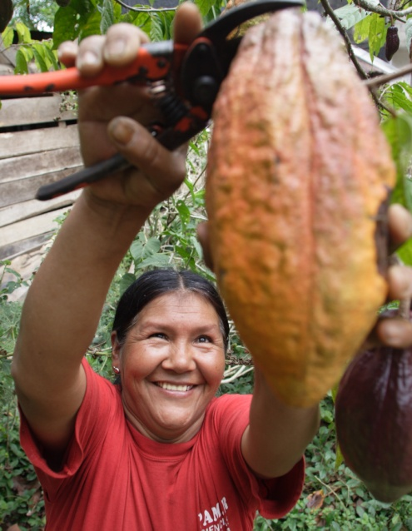
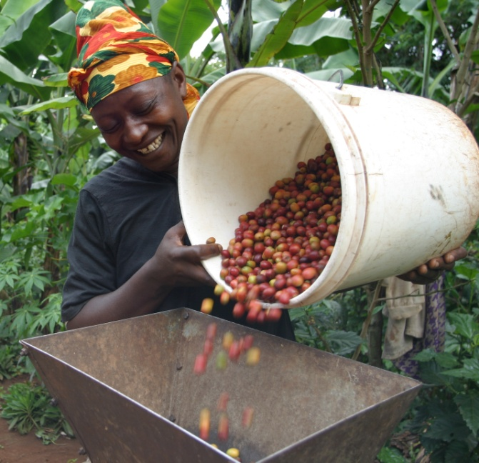
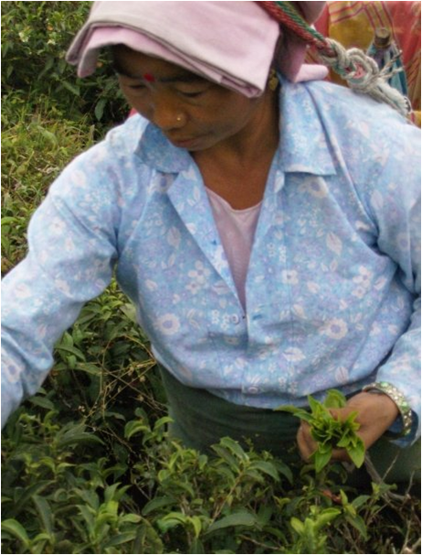
Why cacao, coffee, tea and the other specific products?
Notes:
These foods can’t be grown easily locally, so all are imported. As a result, we are particularly disconnected from the farmers who grow them.
These farmers face many challenges including an inability to gain access the U.S. and other international markets.

Slide 5
How does Fair Trade work?
Fair Trade organizations partner with democratic farmer cooperatives, eliminating middle people—more benefits to farmers and a fair price.
Long-term direct relationships with a partner that farmers can rely upon
Financial loans to farmers so that they can plan and plant for the upcoming year before they receive their money from the harvest.

Slide 6
Living Ethically and in Harmony
Each one of us has a responsibility to protect and sustain our natural world. This includes all of the plants and animals that provide the food to nourish us. We want to ensure a healthy, vibrant Earth for future generations.
Notes:
In so doing we are also respecting the farmers who grow our food. There is a connection between paying farmers a fair price for their crops so that they can remain on the land, feed their families, and have a better quality of life.
Play 2 minute video https://www.youtube.com/watch?v=xYzl_YwTULk&t=3s

Slide 7
Notes:
Double click on the black box to show a 2 minute video on fair trade and the environment https://www.youtube.com/watch?v=xYzl_YwTULk&t=3s

Slide 8
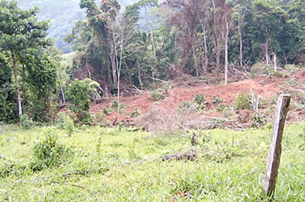
Conventional (non-organic) Farming
Notes:
Conventional (non-organic) farming Conventional farms often clear-cut trees in order to plant a monoculture of coffee. This changes the eco-system and destroys the habitat for wildlife, especially birds who live in the trees.
The removal of trees leads to soil erosion, ultimately making farmland less productive.
With the soil’s natural fertility depleted, conventional farms rely on chemical pesticides, herbicides and fertilizers, which are harmful for the environment, animals and for people’s health.
Pictured is a clear-cut forest in Peru that has suffered a landslide due to deforestation. Equal Exchange coffees are shade grown.

Slide 9
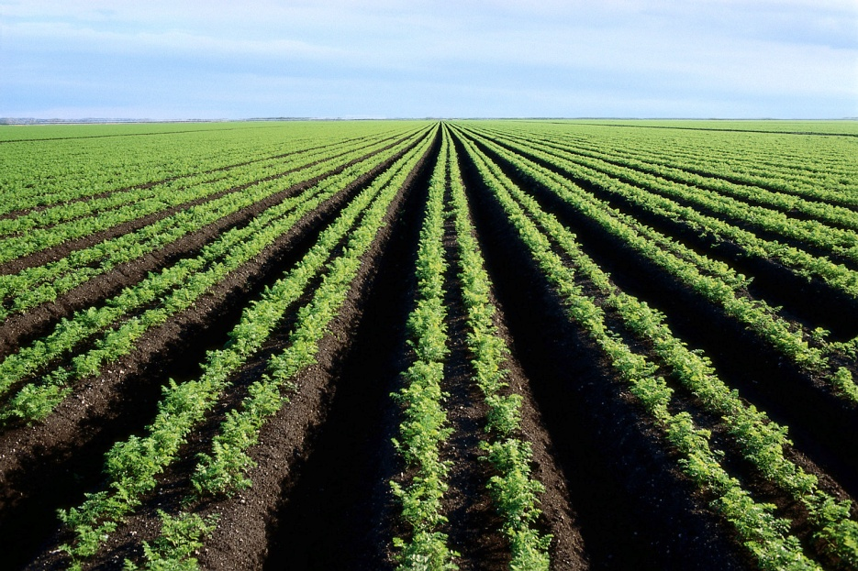
Plantations
Monoculture leads to soil erosion and plants that are more vulnerable to destructive insects and diseases.
Heavily sprayed with chemical fertilizers, pesticides, fungicides.
Bird life destroyed: fewer of them to eat the insects

Slide 10
Climate change
Causes the following:
Drought: malformed or immature coffee cherries
Flooding: mold and cherries that fall off the branch and rot
Unseasonal hard rainfall: cherries that separate from the plant and fall off
Mudslides and Landslides: Large areas of farm are washed away and coffee plants destroyed. Soil erosion/depletion, lower productivity.
Notes:
Climate change affects farmers disproportionately. They only have a limited number of acres (hectares), struggle to feed their family as it is, and few other options for work.

Slide 11
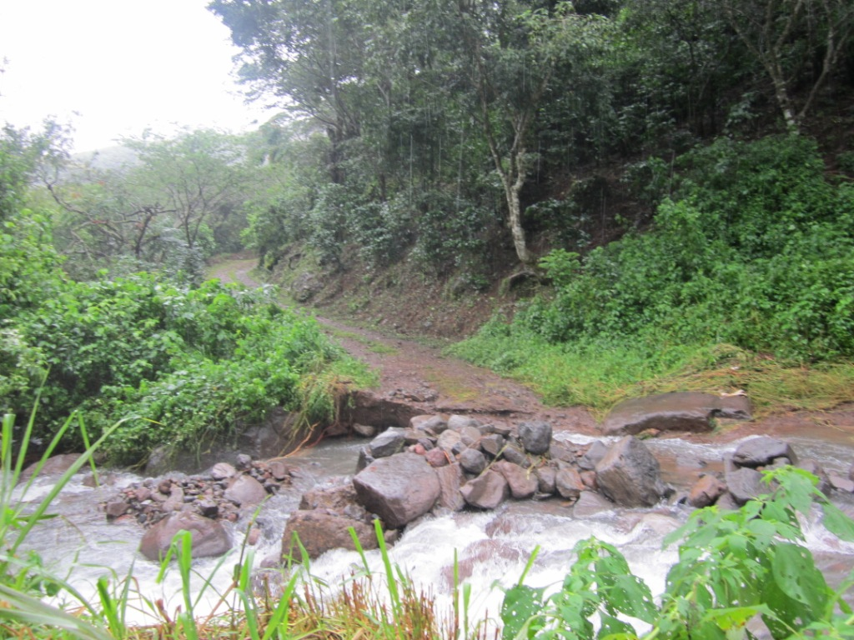
Devastation from flooding
Notes:
Here is the road that the flood washed away.

Slide 12
Plant Disease such as Coffee Rust or “La Roya”
This is a fungus that forms due to a combination of these factors including warmer temperatures and which threatens the future of coffee.
Coffee rust cuts plants off from their nutrient supply. They can’t reproduce and they die.
A regional crisis in Central America over the past three coffee seasons . In some places 50-80% of the coffee crops have been lost.

Slide 13
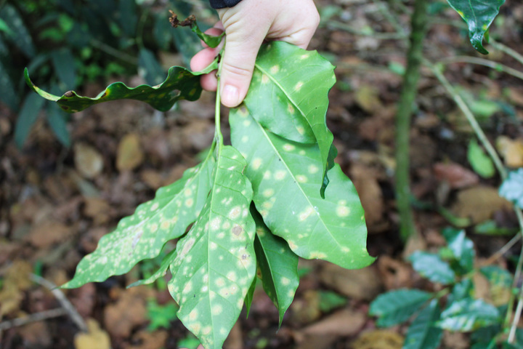
Notes:
Yellowish brown spots appear on the leaves of the coffee plant.

Slide 14
Organic Coffee Farming
Notes:
Organic farming is better for the earth, animals, plants and people that grow it and people that consume it.

Slide 15
Innovative Farming Techniques
Biodiversity: planting diverse tree and plant species, i.e., cacao, citrus, banana, etc. Fewer attacks by diseases and insects. More migratory birds to eat insects.
Conservation and protection of soil and water, i.e., composting discarded coffee fruit to enrich the soil

Slide 16
Other Organic Techniques
Replenishment of soil using beneficial microorganisms which improve the absorption of nutrients
Use of vermiculture and natural soil supplements
Clearing out diseased coffee, selective pruning
Replanting stronger disease resistant plants
Notes:
Microorganism- a microscopic organism, especially a bacterium or fungus
Vermiculture - the use of specially bred worms to convert organic matter into compost

Slide 17
Organic Compost
Notes:
At CONACADO cooperative in the Dominican Republic

Slide 18
What can you do? Get your community involved!
Serve organic, fairly traded coffee, tea, and chocolate in your school or community
Sell organic, fair trade products at fairs and farmers markets
Design Fair Trade fund raising projects
Organize an educational program for adults or children
Host an educational chocolate or coffee tasting
Attend a delegation with Equal Exchange to visit farmers

Slide 19
Building Relationships
Notes:
We have a very relational view of Fair Trade. Connecting people- from those growing the food to those eating it, like on this delegation, helps build a stronger food system based on reality.
Long-term, direct relationships between farmers and Equal Exchange

Slide 20
Organic Coffee Cherries
Notes:
Here are red coffee cherries from Las Colinas cooperative in El Salvador- beautiful! They make for the best coffee.
A main priority is to focus on maintaining and improving productivity at the farm level. The theory is: increased productivity increases farm income and increased farm income decreases pressure to exploit the natural resources available in the biosphere.

Slide 21
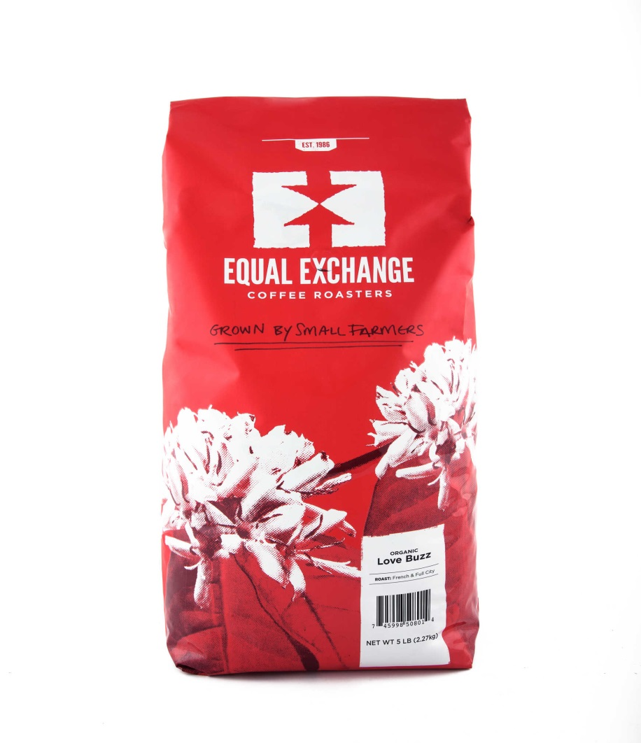
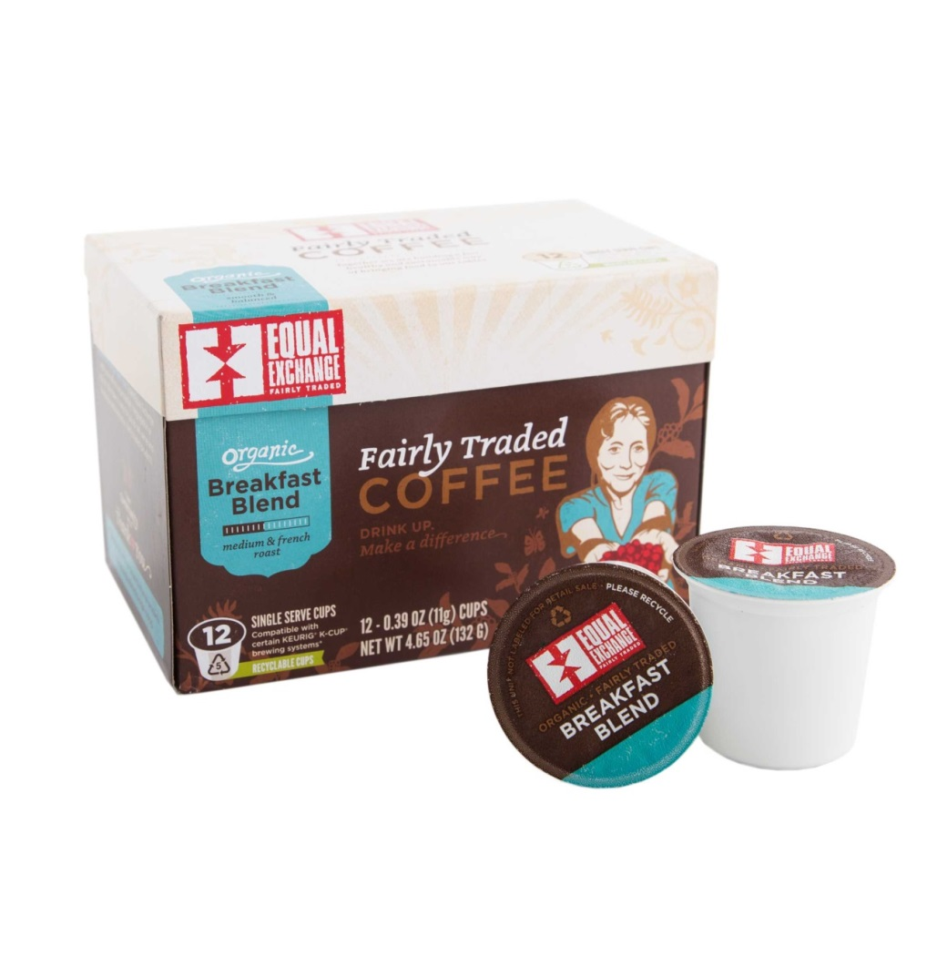
Organic Coffees
Notes:
Buy in bulk, 5lb bags to reduce packaging. Why would Equal Exchange promote single serve (K-cups)? Our single serve cups are actually recyclable! Number 5 plastic cup, a foil lid and compostable filter and grounds. Making a single cup is less wasteful than making an entire pot if there is a chance that it will sit there and be thrown out.

Slide 22
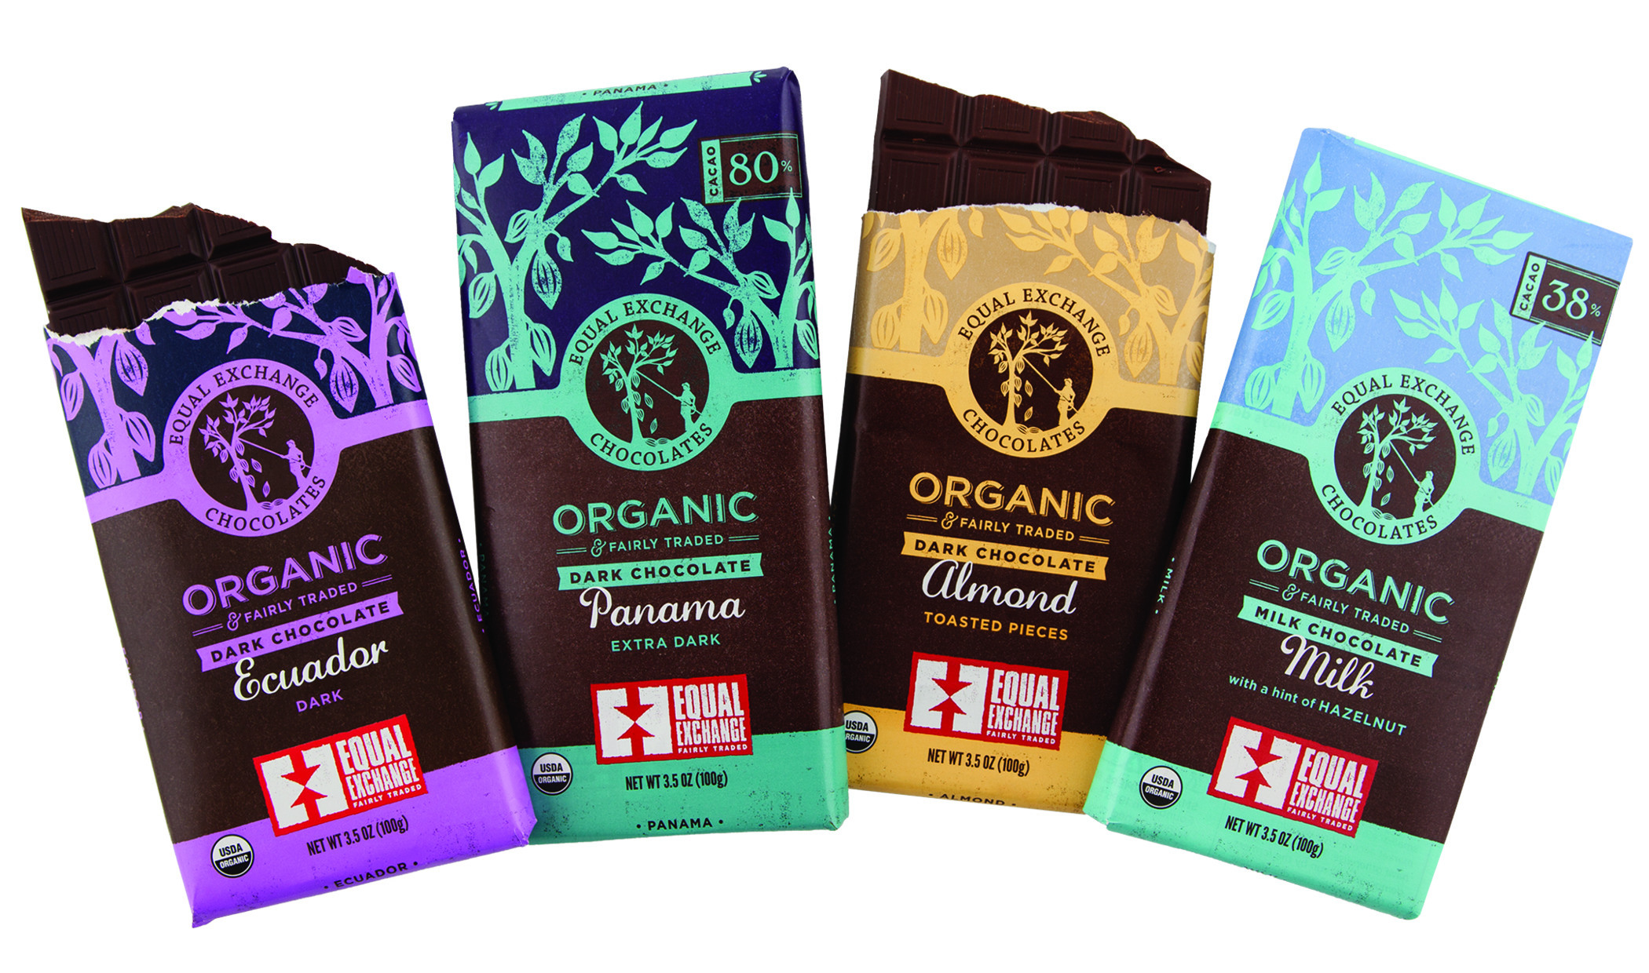
Organic Chocolate Bars
Notes:
Recycle your wrappers!

